Slide 1
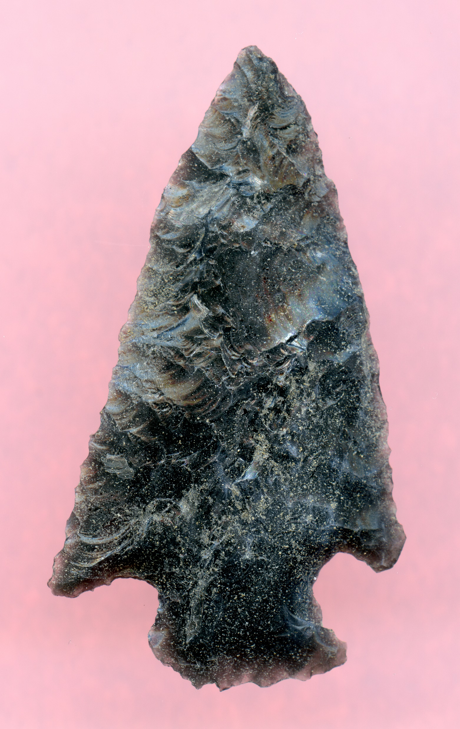
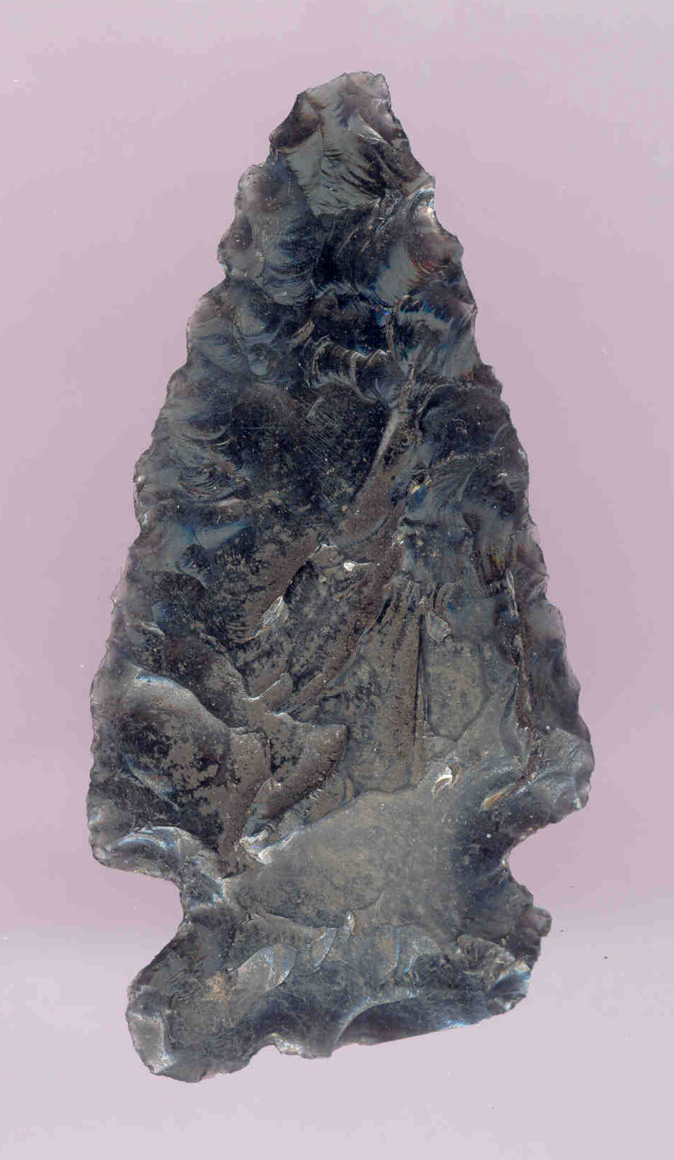
X-RAYS, OBSIDIAN, AND LAVA CAVES: ARCHAEOLOGICAL INVESTIGATIONS OF SOME UNUSUAL ARTIFACTS FROM THREE CENTRAL OREGON LAVA TUBES
XRF SOURCE ANALYSIS
OBSIDIAN HYDRATION DATING
RADIOCARBON DATING
AND … BEARS
CRAIG SKINNER, NWROSL
PENNI BORGHI, DESCHUTES NF

Slide 2
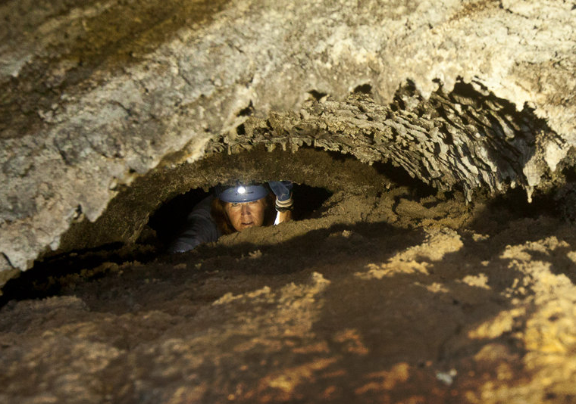
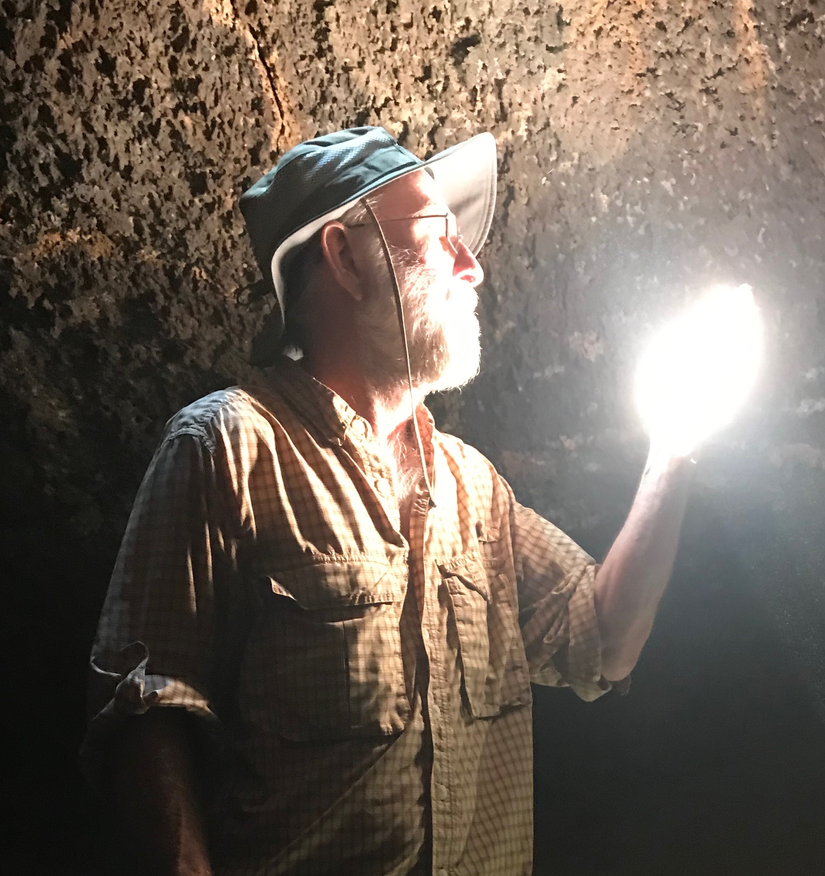
WHO ARE WE?
PENNI BORGHI
CRAIG SKINNER

Slide 3
INTRODUCTION
A SUMMARY OF OUR STILL-ONGOING ARCHAEOLOGICAL RESEARCH AT THREE CENTRAL OREGON LAVA TUBE CAVES
WHY ARE THE ARTIFACTS UNUSUAL: ELEVEN OBSIDIAN TOOLS FOUND IN THE TOTAL DARKNESS ZONE OF THE THREE CAVES
METHOD 1. XRF SOURCE ANALYSIS OF THE TOOLS
METHOD 2. OBSIDIAN HYDRATION ANALYSIS OF THE TOOLS
METHOD 3. RADIOCARBON DATING OF ASSOCIATED CHARCOAL … NOT TO MENTION BEARS AND A LITTLE BLOOD

Slide 4
OUR RESEARCH OBJECTIVES
IDENTIFY THE GEOLOGIC SOURCES OF THE ARTIFACTS USING X-RAY FLUORESCENCE TRACE ELEMENT ANALYSIS
ESTIMATE THE AGE OF MANUFACTURE OF THE ARTIFACTS WITH OBSIDIAN HYDRATION ANALYSIS
ESTIMATE THE AGE THAT THE ARTIFACTS WERE LEFT IN THE CAVES USING RADIOCARBON DATING OF ASSOCIATED CHARCOAL
SPECULATE HOW THESE ARTIFACTS GOT WHERE THEY WERE FOUND AND WHY

Slide 5
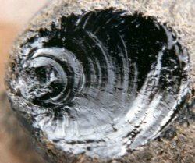
WHAT IS OBSIDIAN?
A NATURALLY-OCCURRING VOLCANIC GLASS
FORMS FROM VISCOUS HIGH-SILICA MAGMAS
CHARACTERIZED BY CONCHOIDAL FRACTURE
HAS A VERY SHARP EDGE AND SMOOTH SURFACE WHEN FRACTURED
A PREFERRED MATERIAL FOR TOOL MANUFACTURE WHEREVER FOUND
OCCURS IN MANY LOCATIONS IN OREGON AND THE PACIFIC NORTHWEST

Slide 6
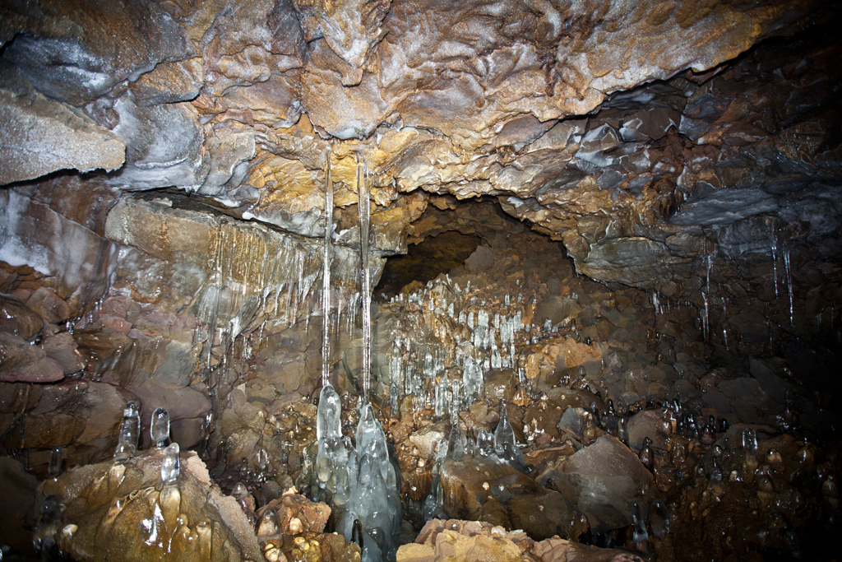
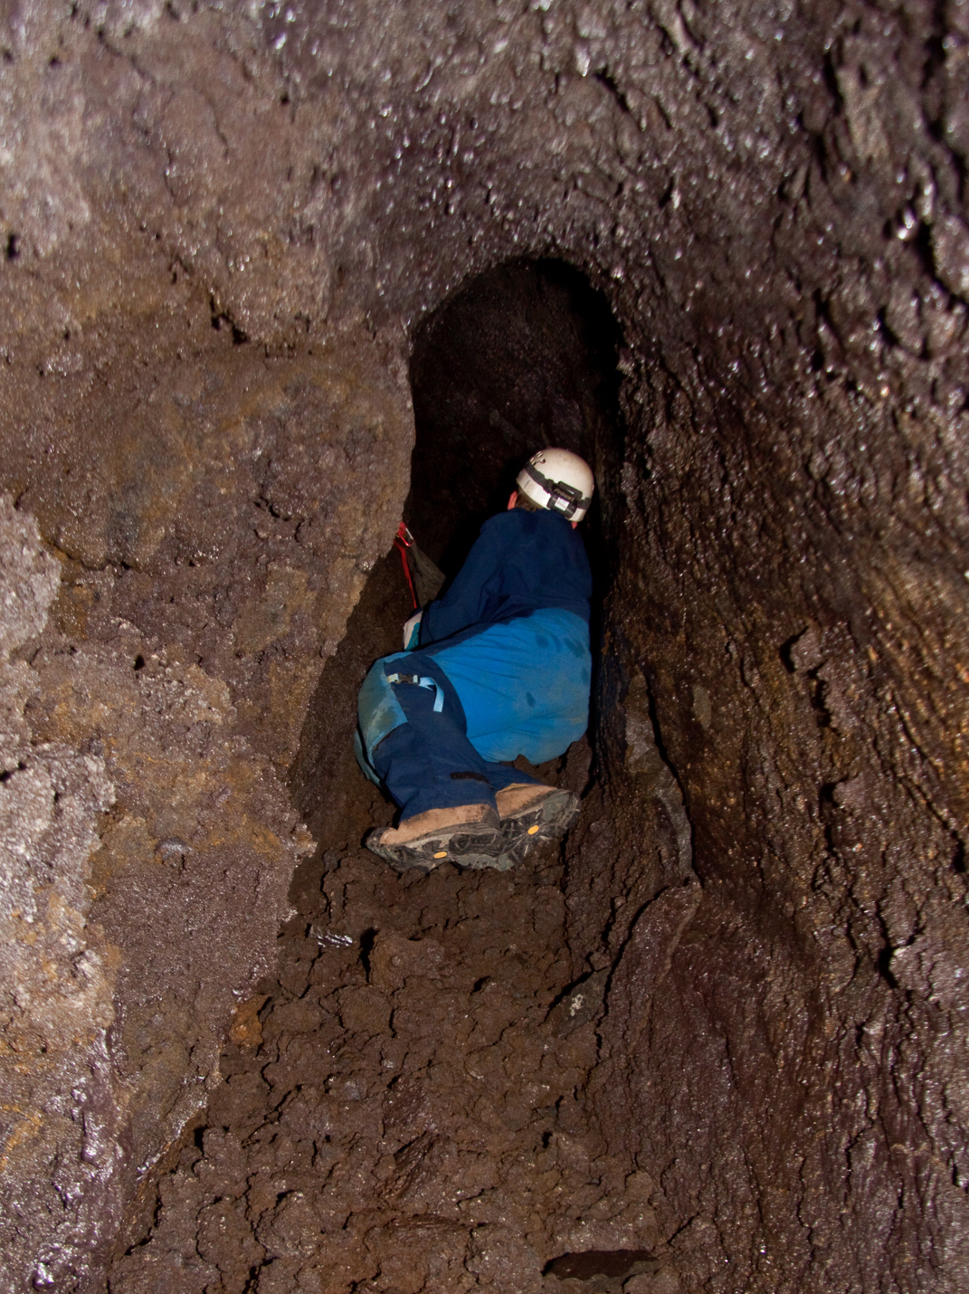
THE CAVES
THREE LAVA TUBE CAVES - CAVES A, B, AND C - OF SIGNIFICANT COMPLEXITY AND LENGTH ARE LOCATED ON THE EASTERN SLOPE OF THE CENTRAL OREGON CASCADES

Slide 7
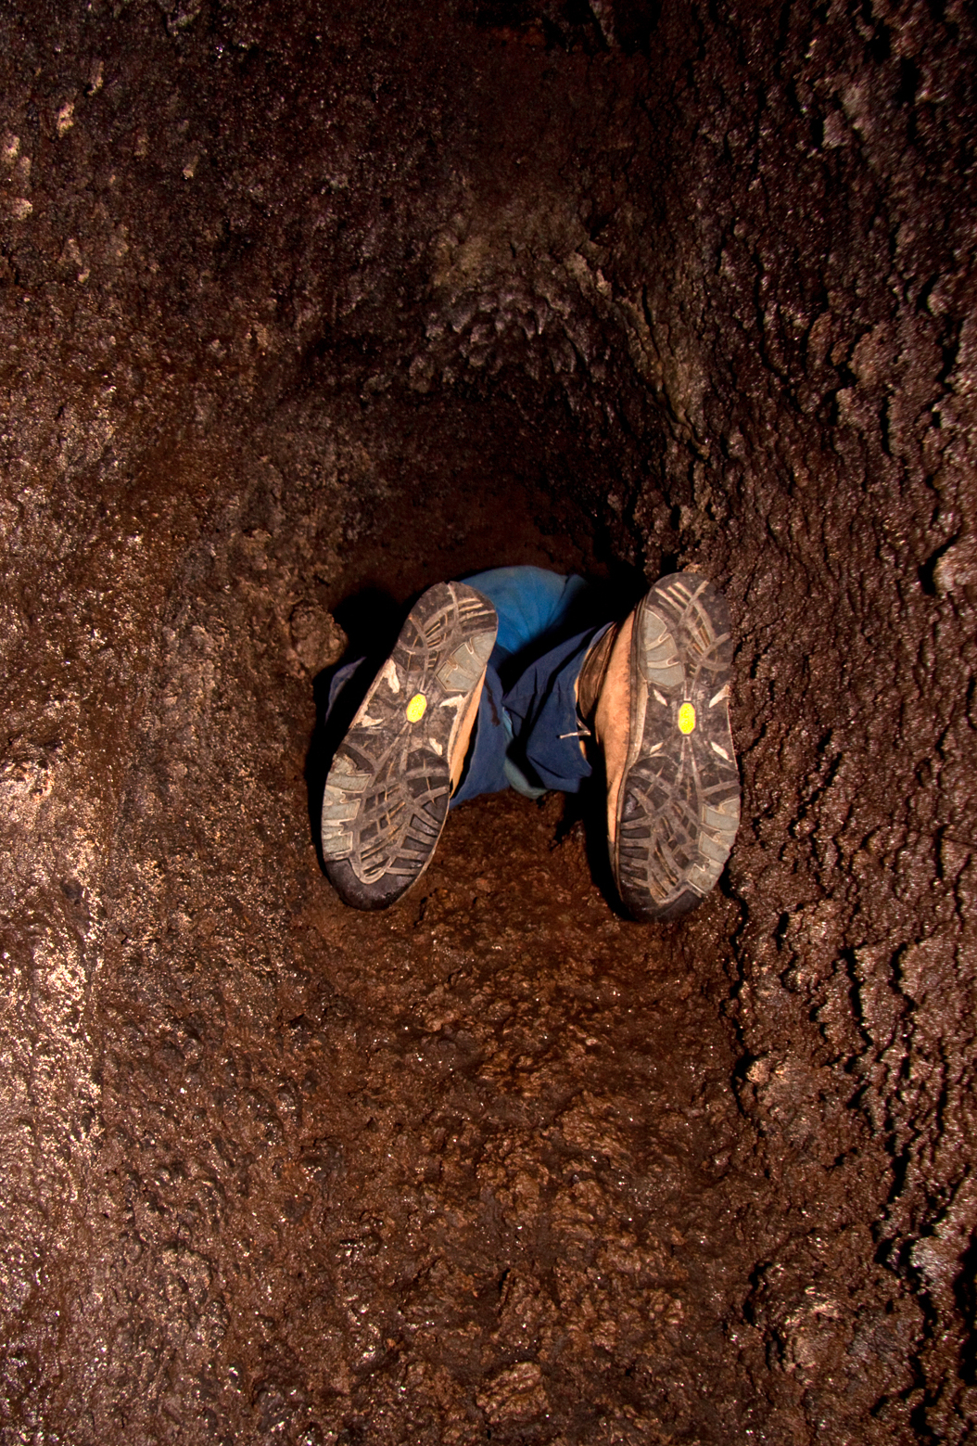
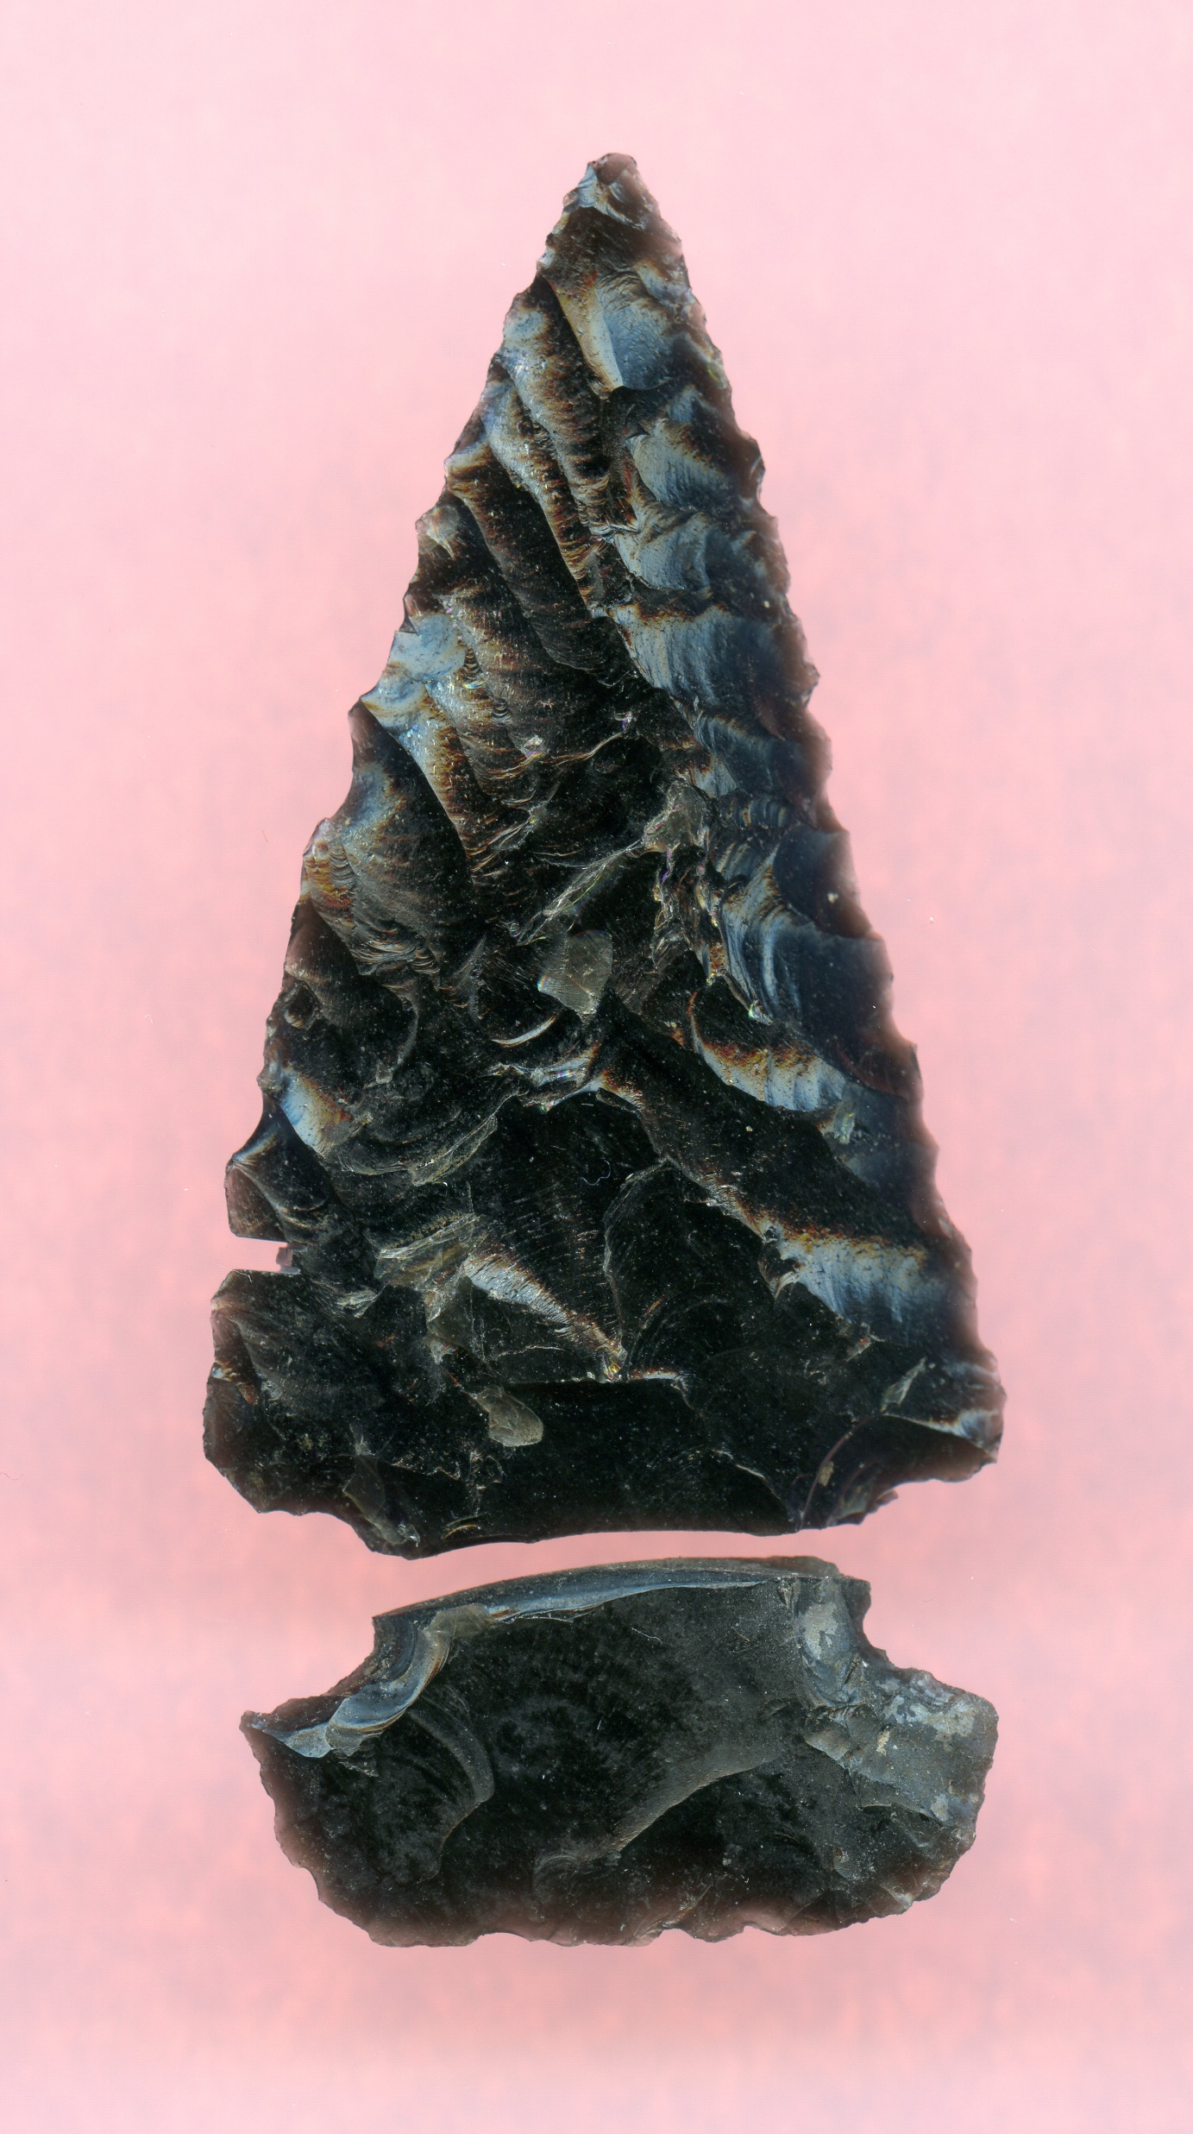
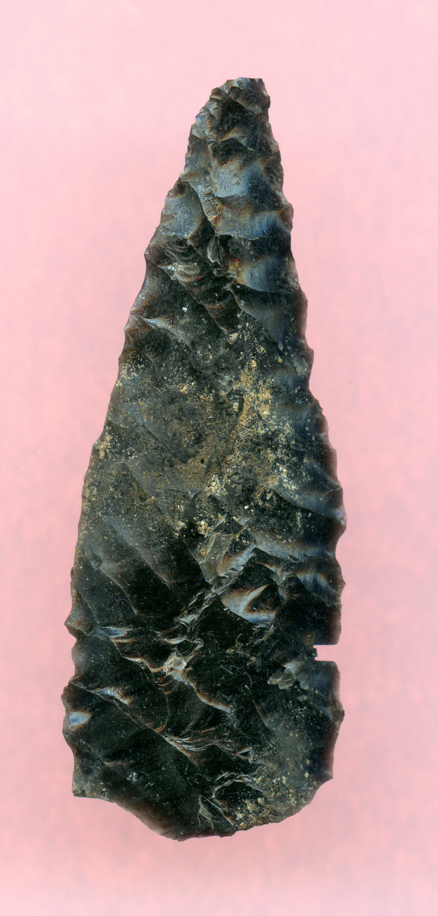
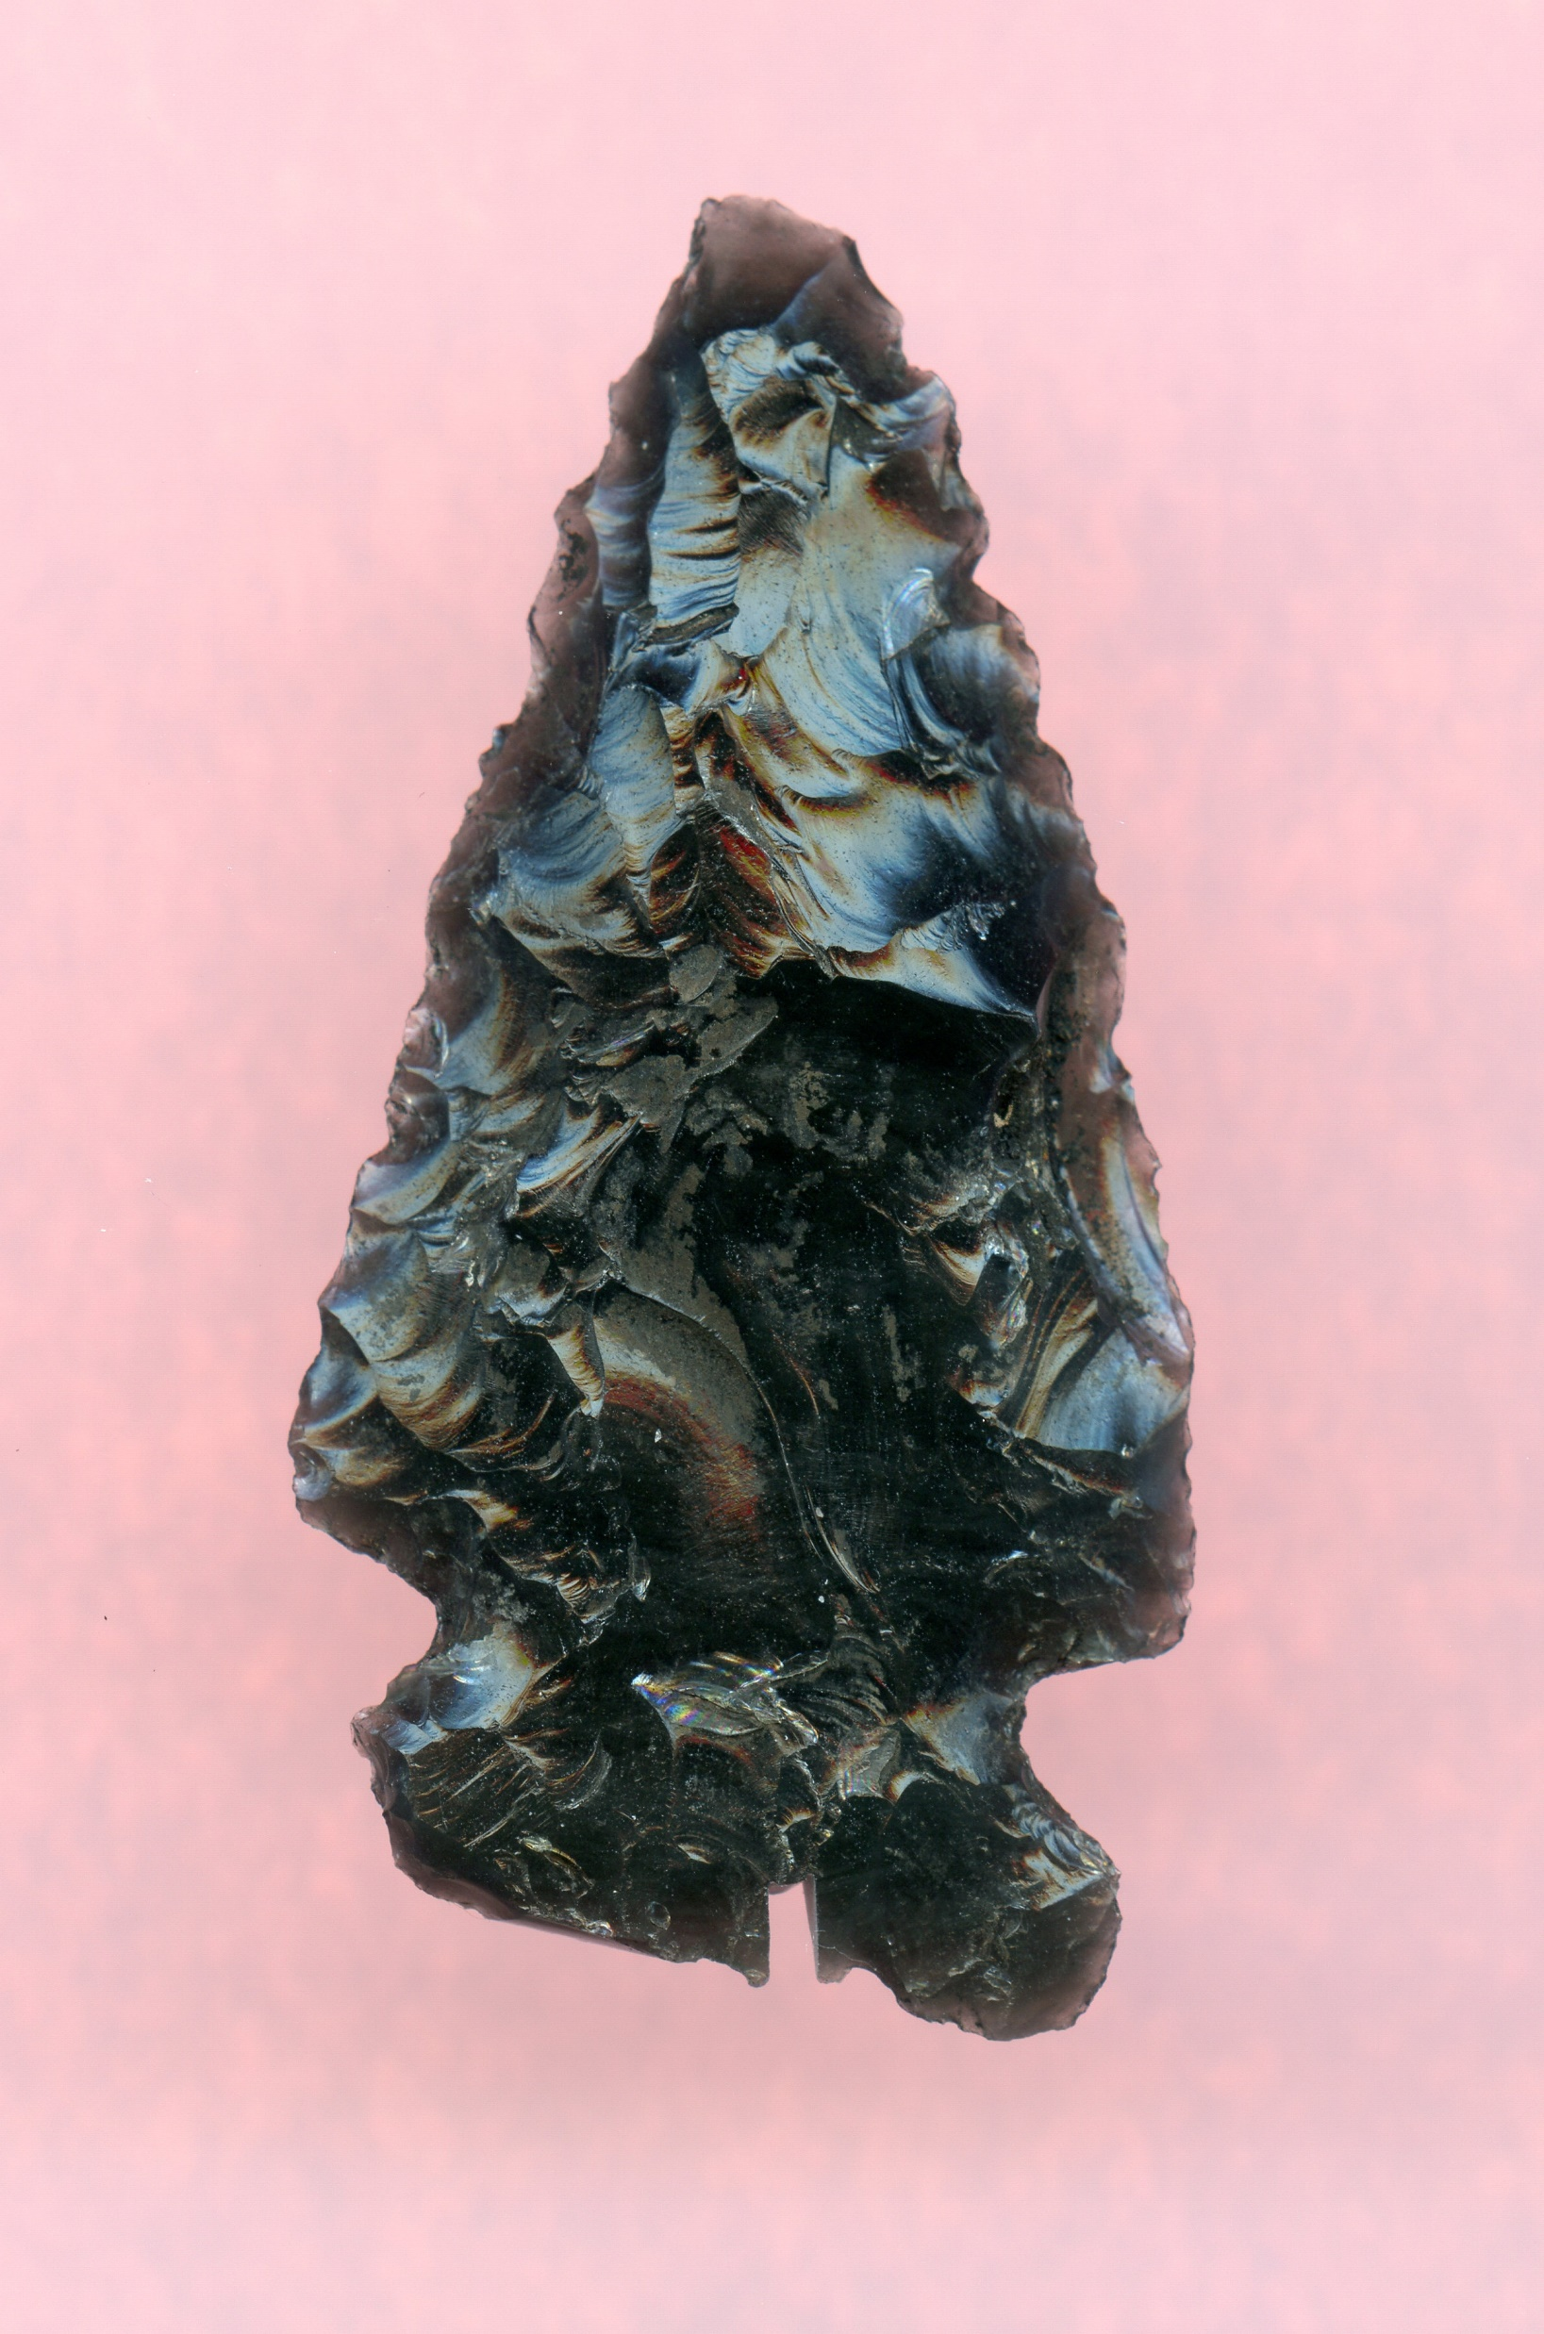
CAVE A (N=4)

Slide 8
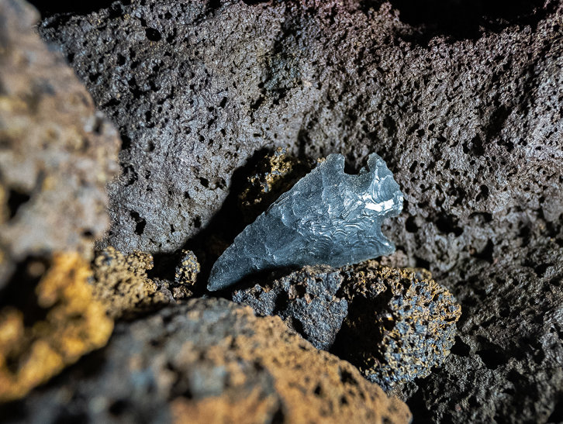
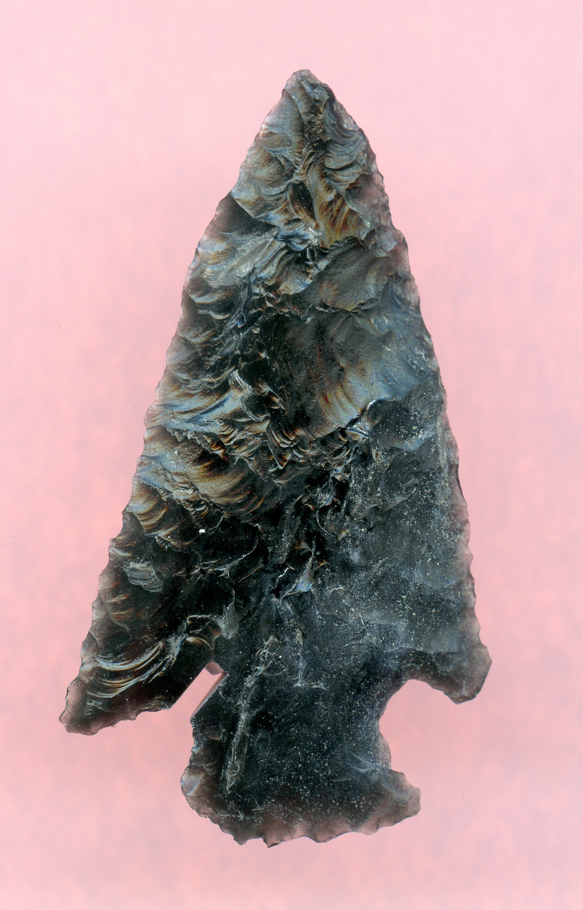
CAVE B (N=2)

Slide 9
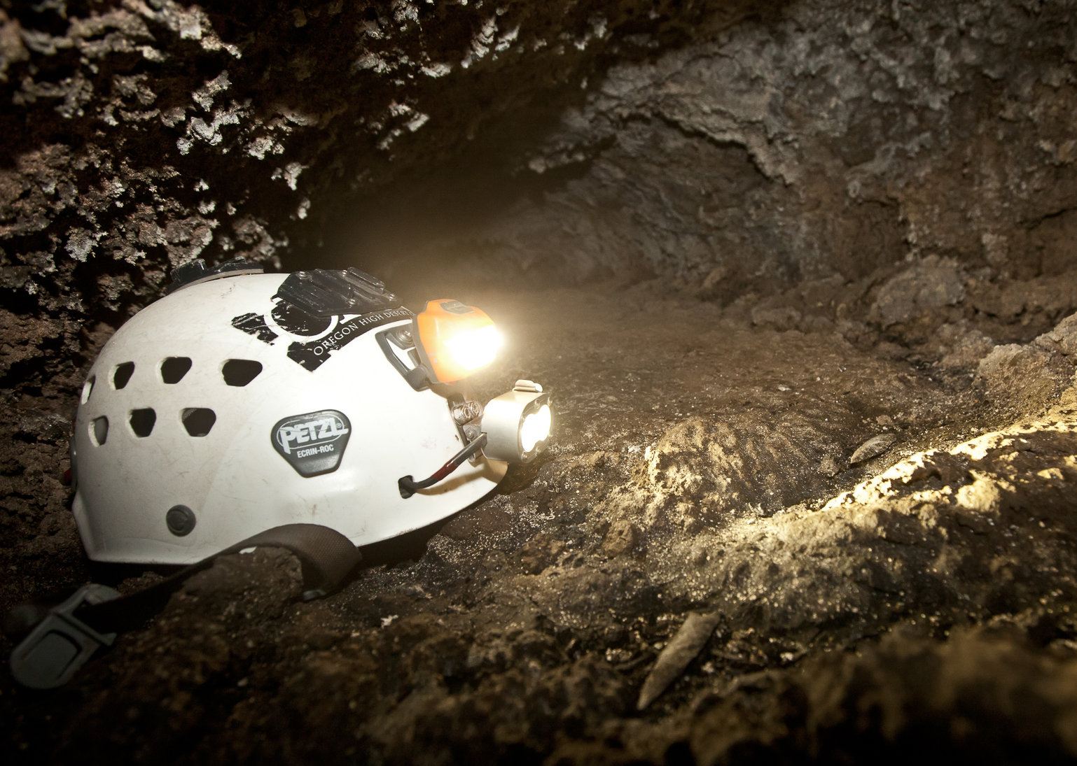
CAVE C (N=5)

Slide 10
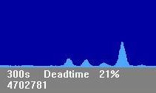
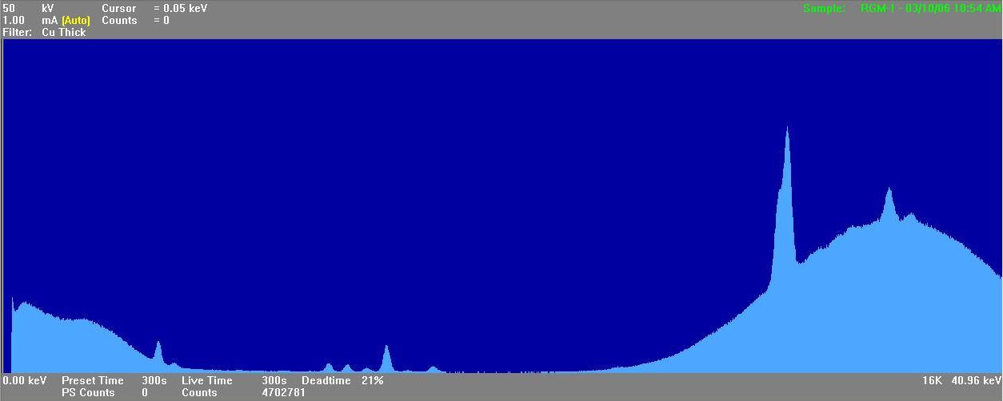
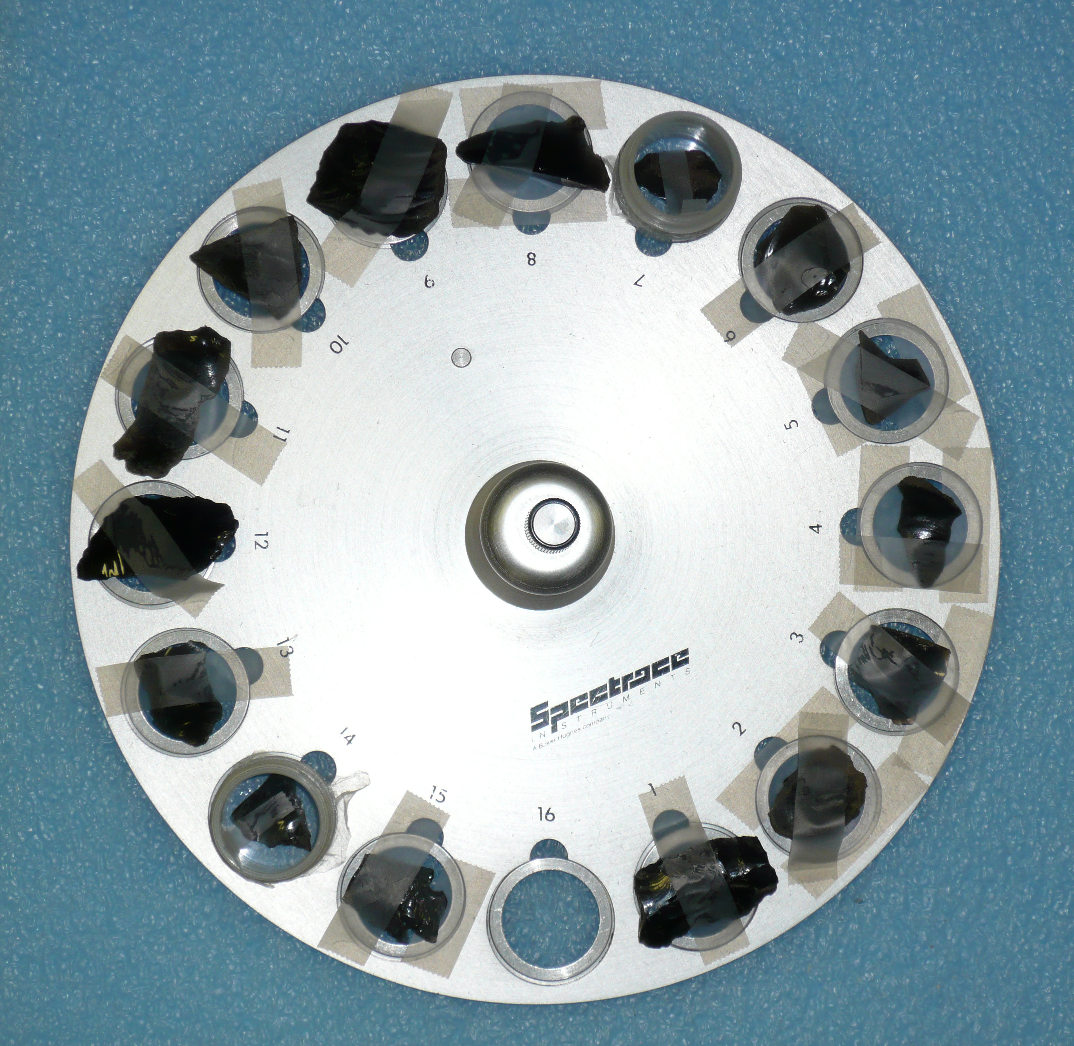
1. X-RAY SOURCING STUDIES: THE XRF SPECTROMETER IN ACTION

Slide 11
X-RAY SOURCING STUDIES: THE BASICS
AN X-RAY FLUORESCENCE SPECTROMETER IS USED TO DETERMINE THE TRACE ELEMENT COMPOSITION OF AN OBSIDIAN ARTIFACT
EACH OBSIDIAN SOURCE HAS A DISTINCT GEOCHEMICAL PROFILE OR FINGERPRINT
THE CHEMICAL FINGERPRINT OF THE ARTIFACT IS COMPARED TO AN EXTENSIVE LIBRARY OF SOURCE PROFILES, AND THE GEOLOGIC SOURCE CAN BE DETERMINED

Slide 12
RESULTS OF OBSIDIAN XRF SOURCE ANALYSIS
FOUR DIFFERENT OBSIDIAN SOURCES WERE IDENTIFIED AFTER THE XRF ANALYSIS OF THE 11 ARTIFACTS
 | OBSIDIAN SOURCES
SITE | GLASS BUTTES 1 | NEWBERRY VOLCANO | OBSIDIAN CLIFFS | SILVER LAKE/ SYCAN MARSH | TOTAL
CAVE A | — | 3 | 1 | — | 4
CAVE B | 1 | — | 1 | — | 2
CAVE C | — | 1 | 3 | 1 | 5
TOTAL | 1 | 4 | 5 | 1 | 11

Slide 13
XRF RESULTS: SCATTERPLOT
TRACE ELEMENT 1
TRACE ELEMENT 2

Slide 14
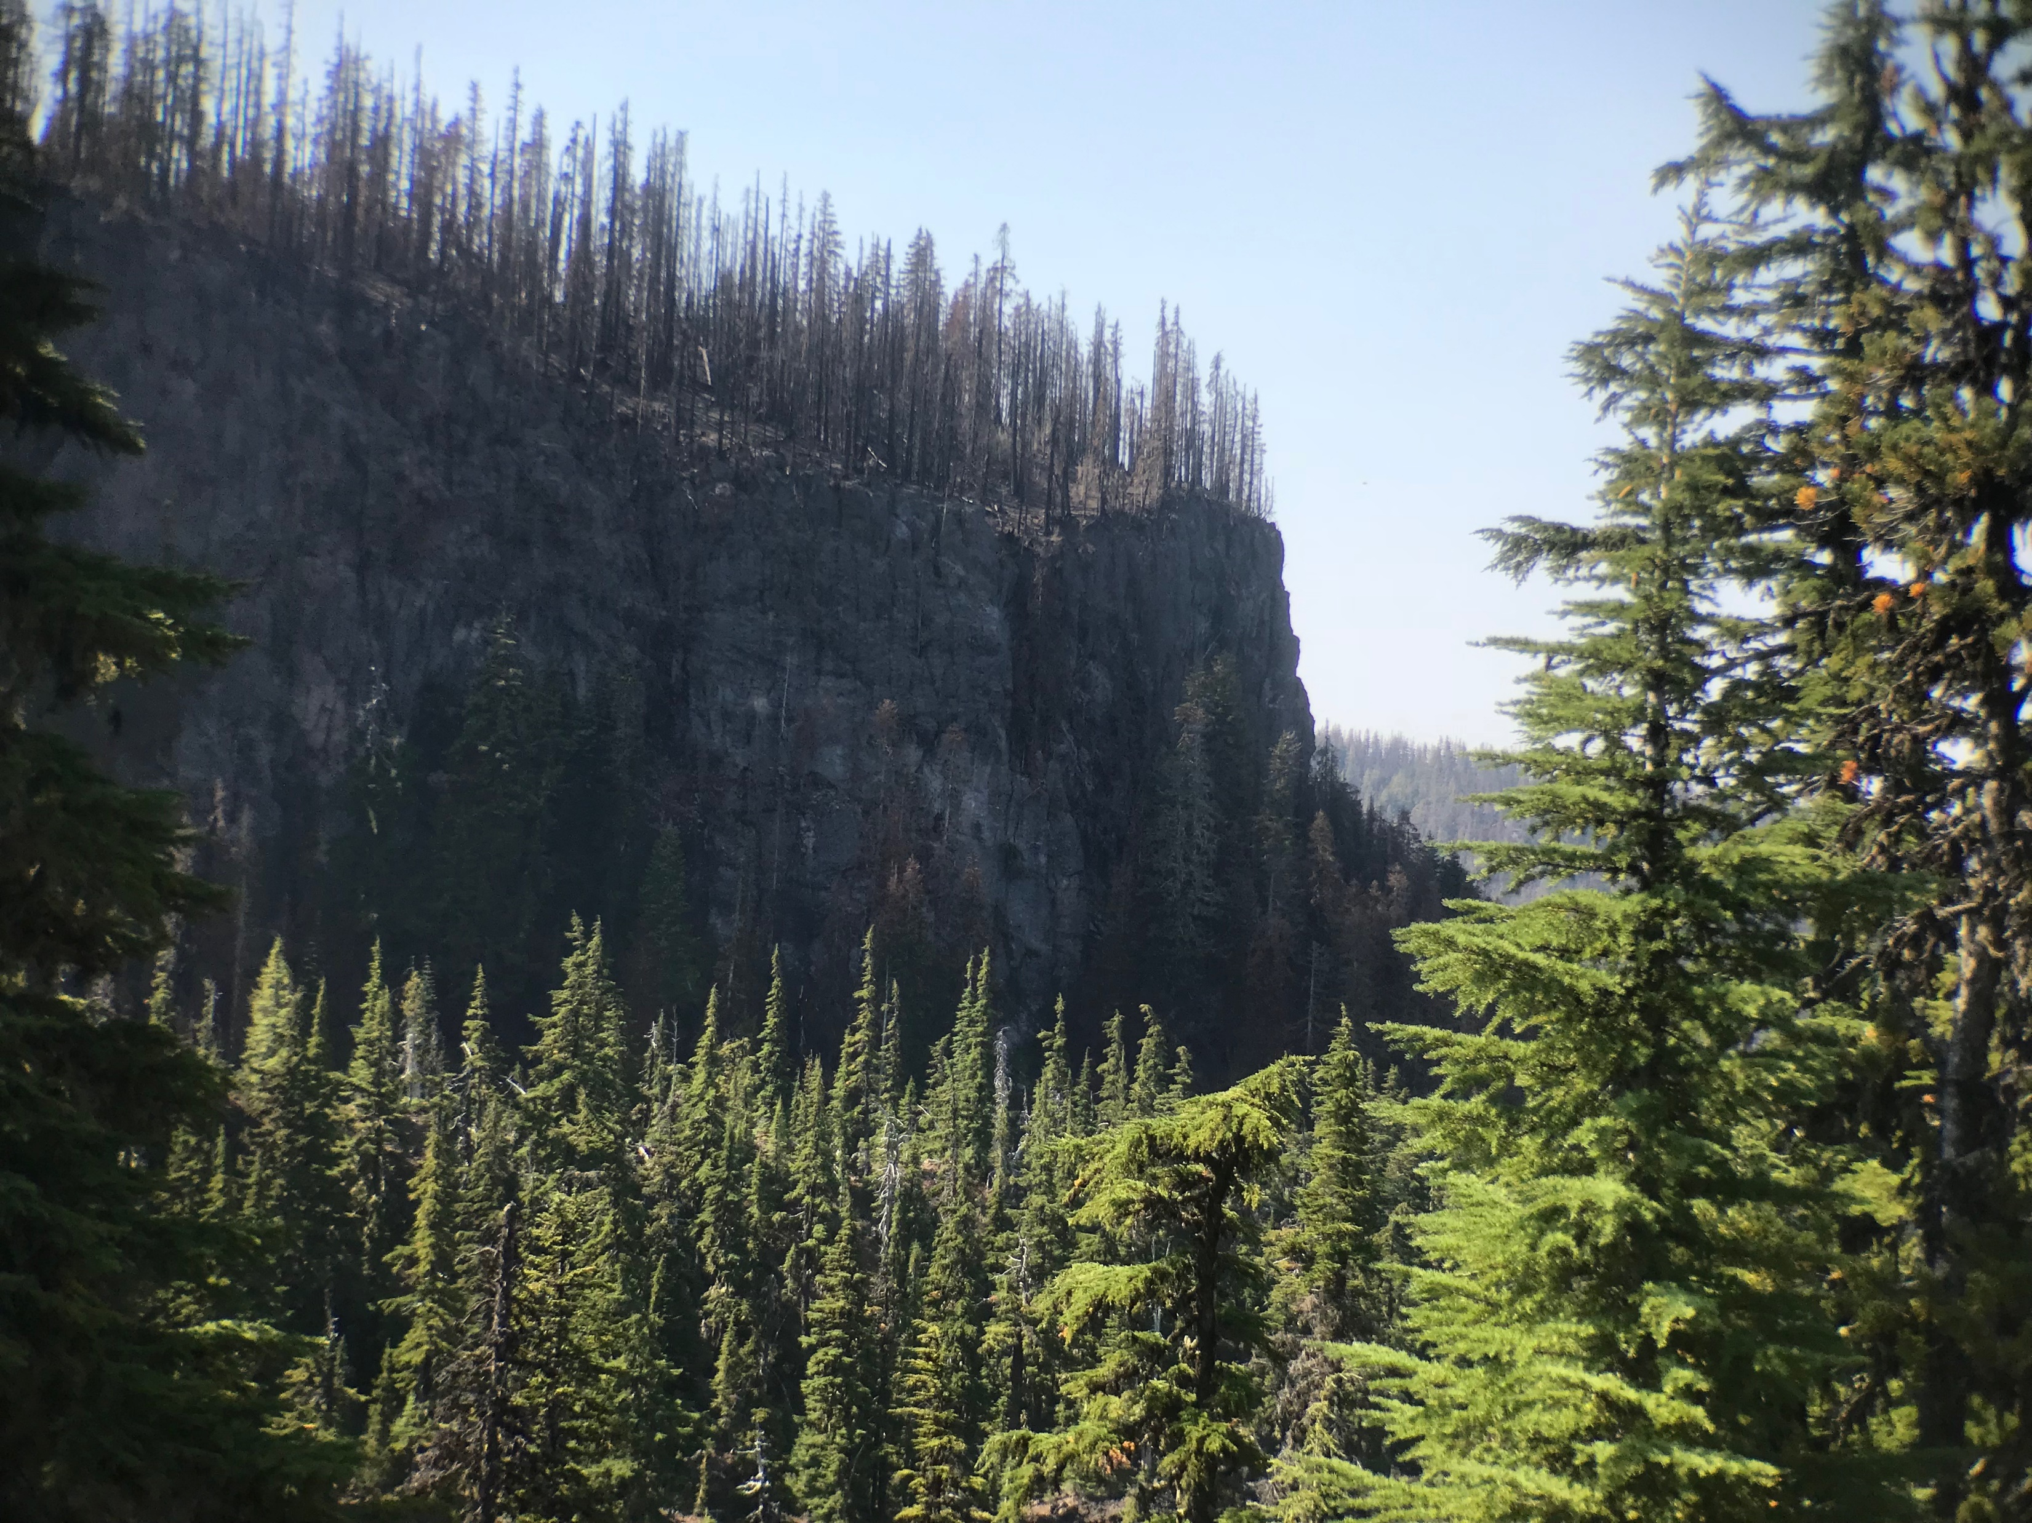
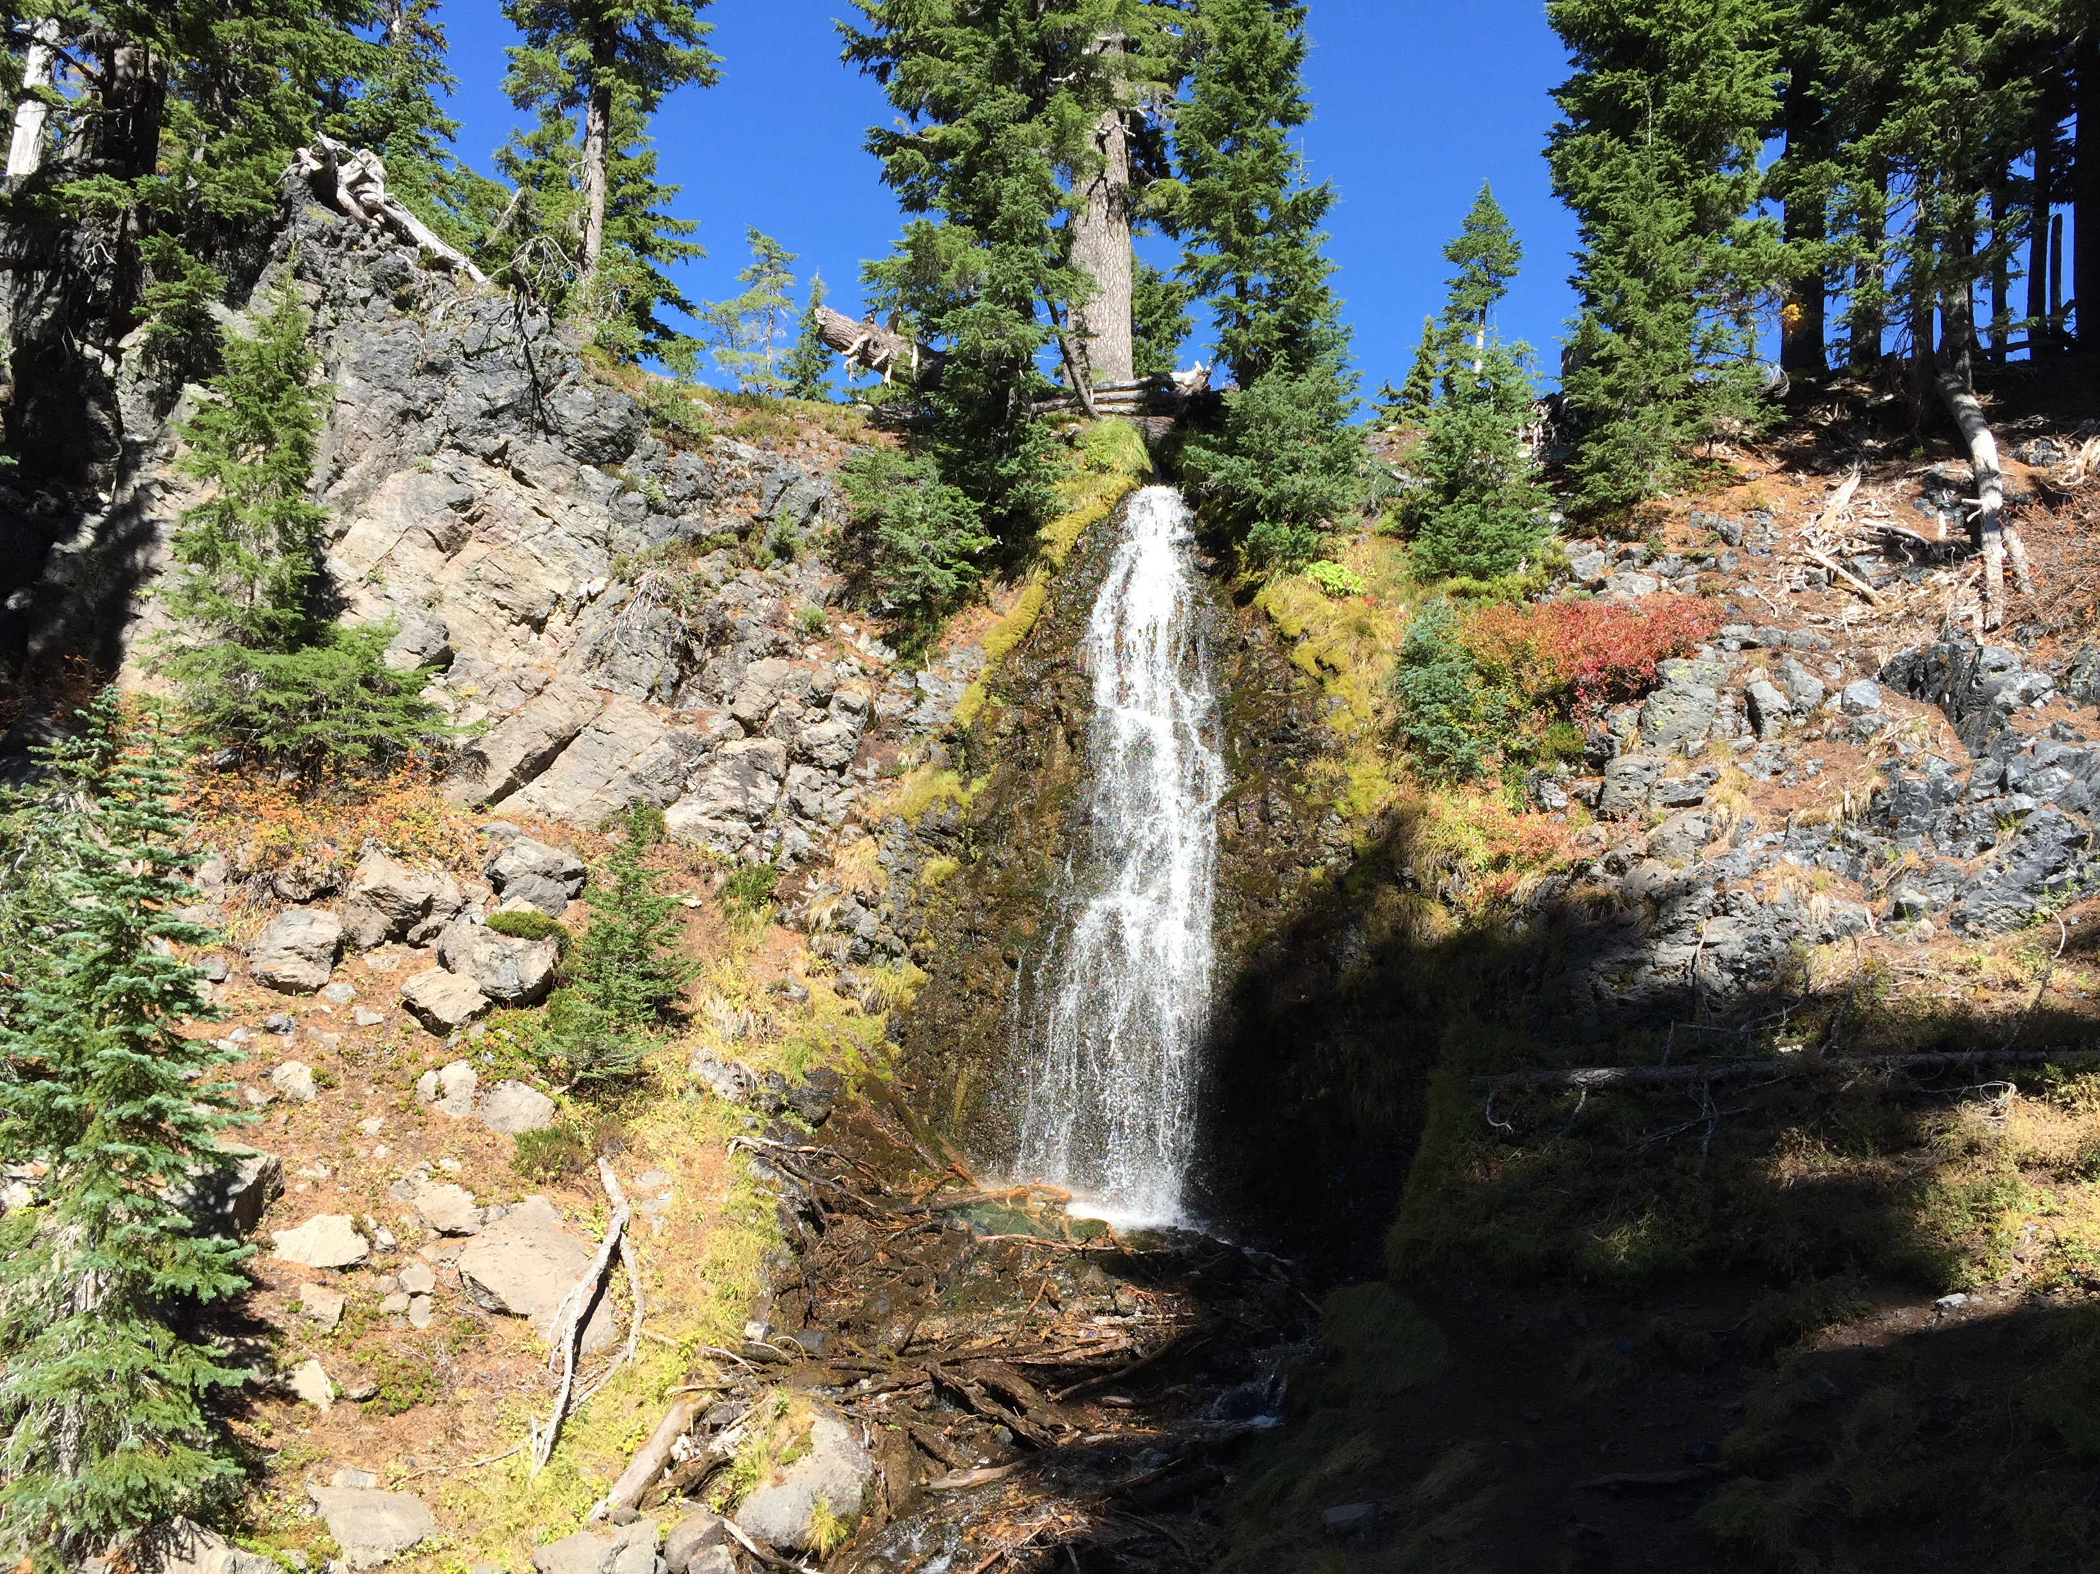
OBSIDIAN SOURCE 1: OBSIDIAN CLIFFS
THE SOURCE CLOSEST TO THE CAVES

Slide 15
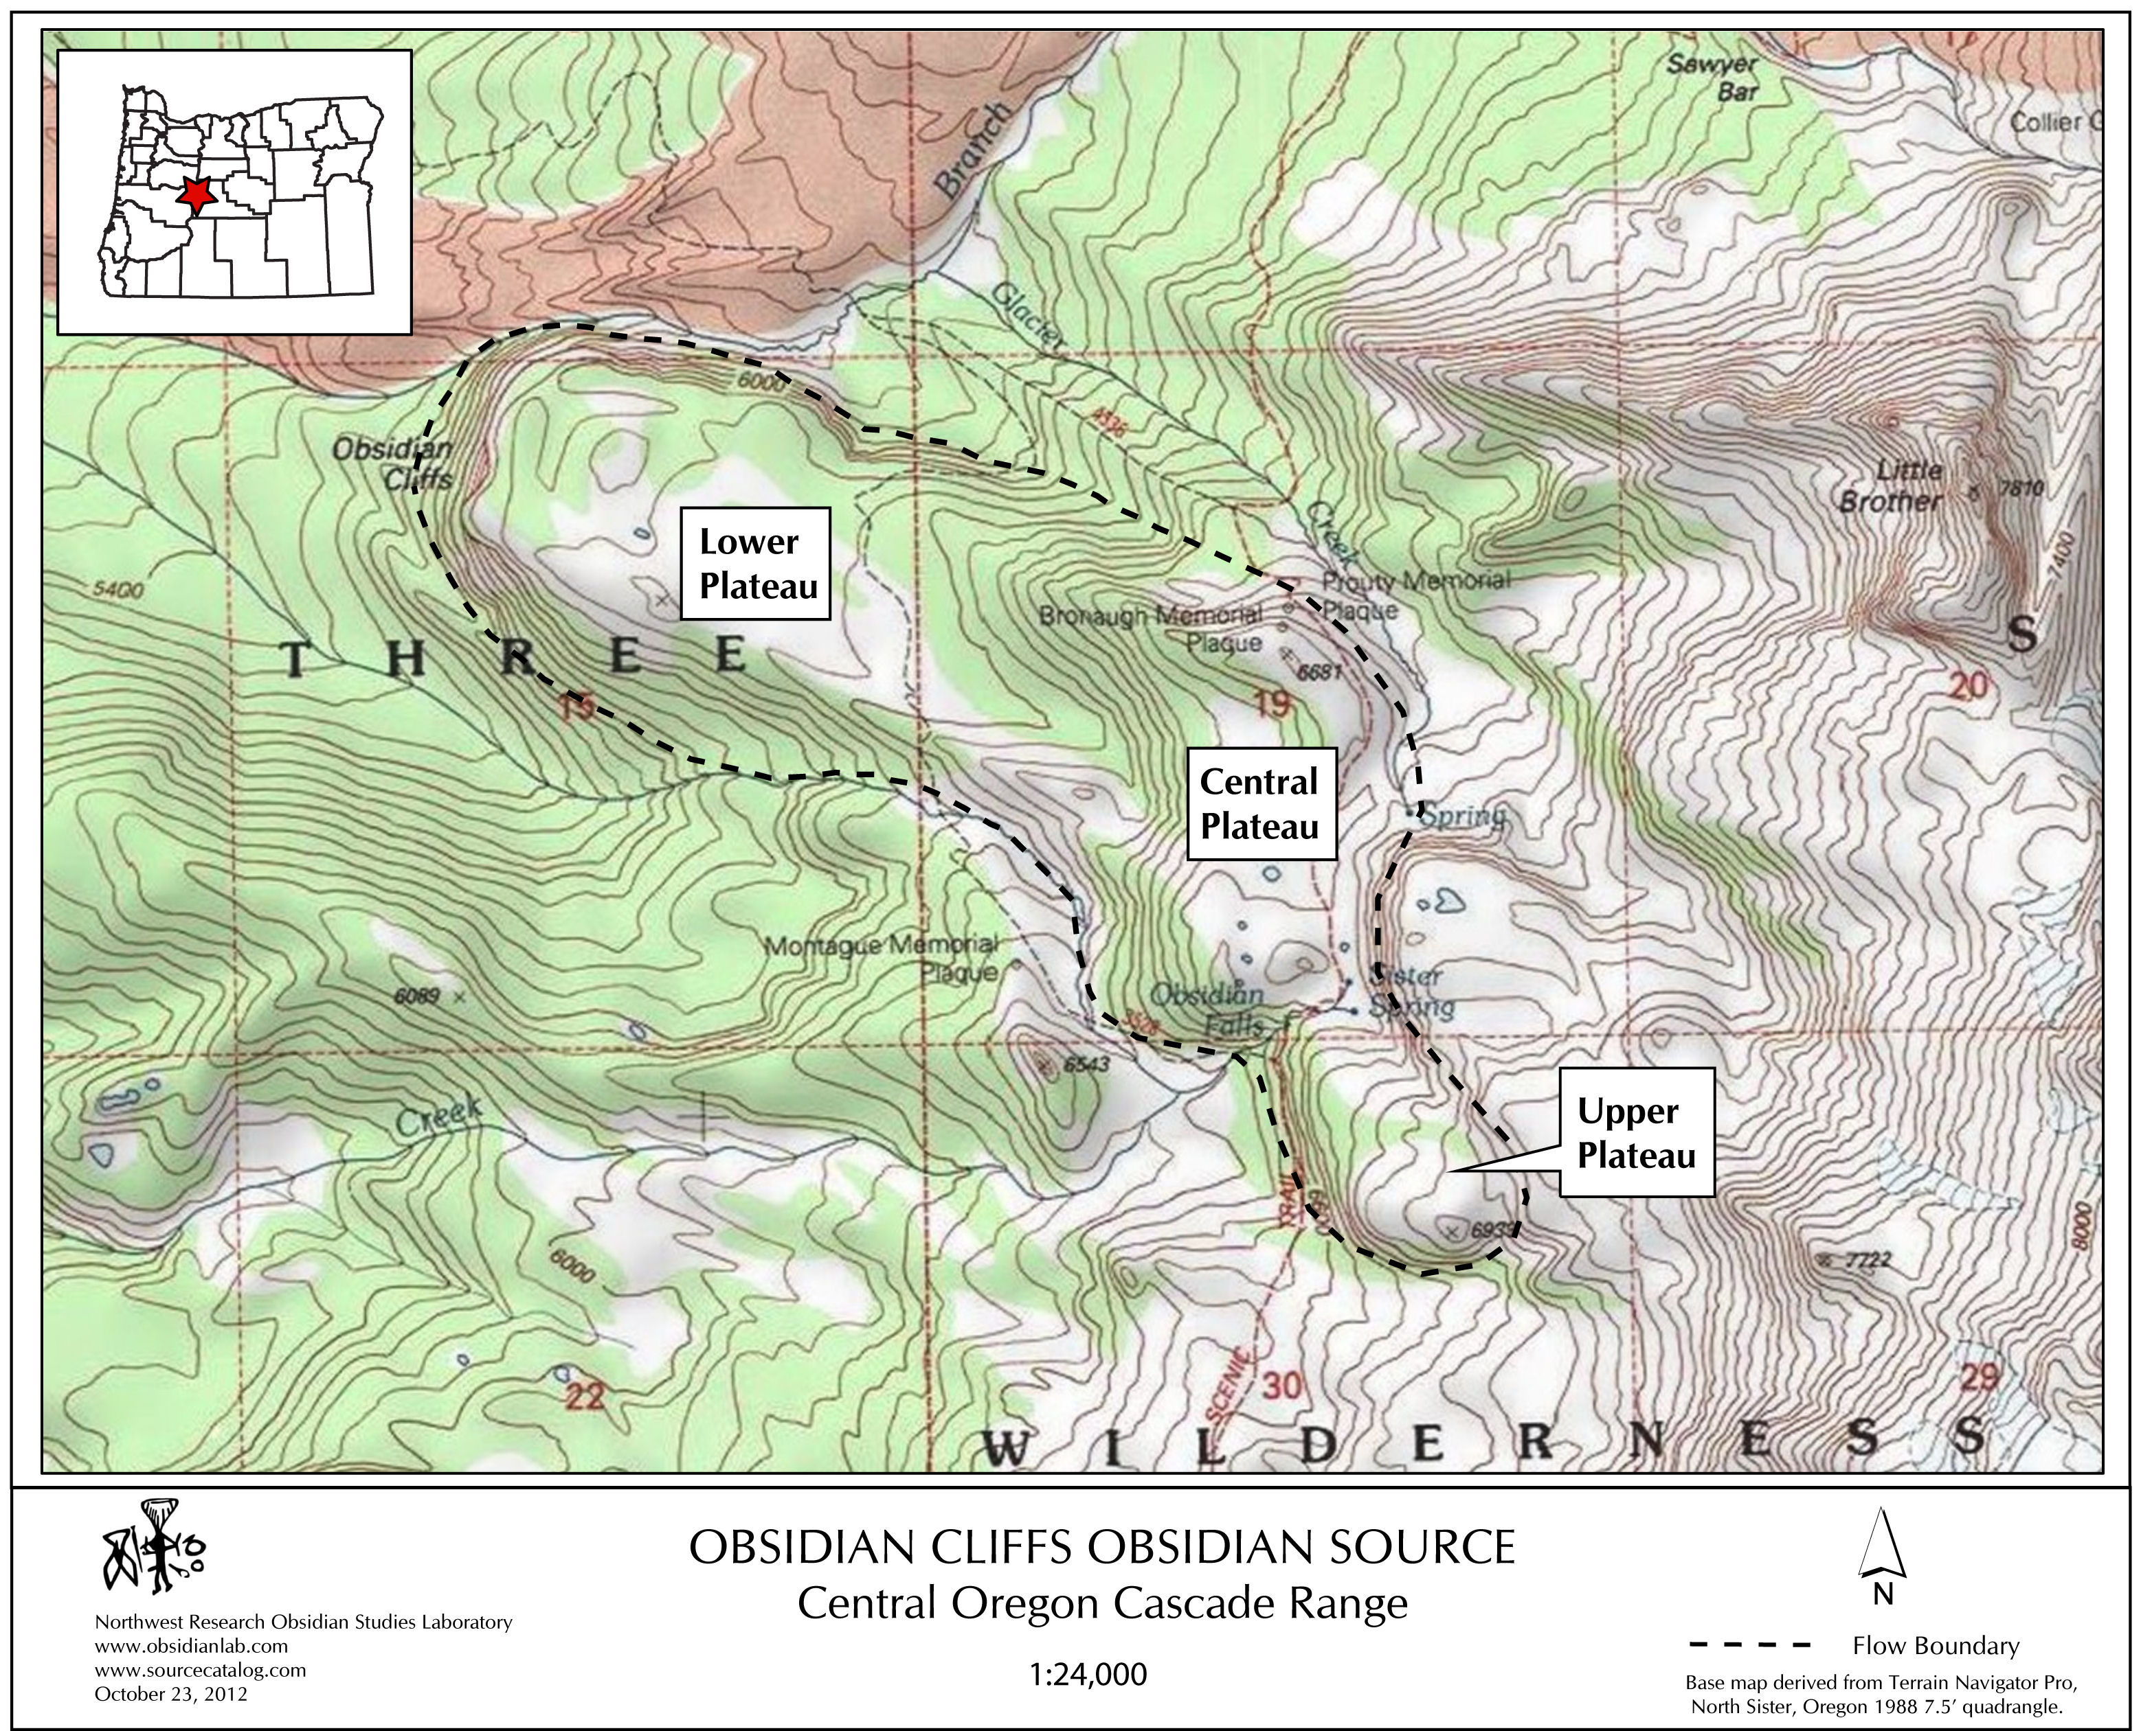
OBSIDIAN PLATEAU

Slide 16
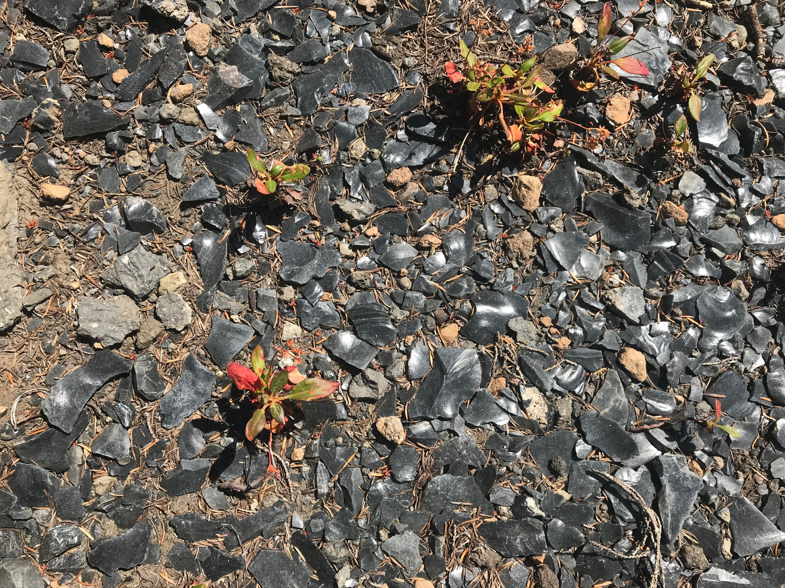

Slide 17
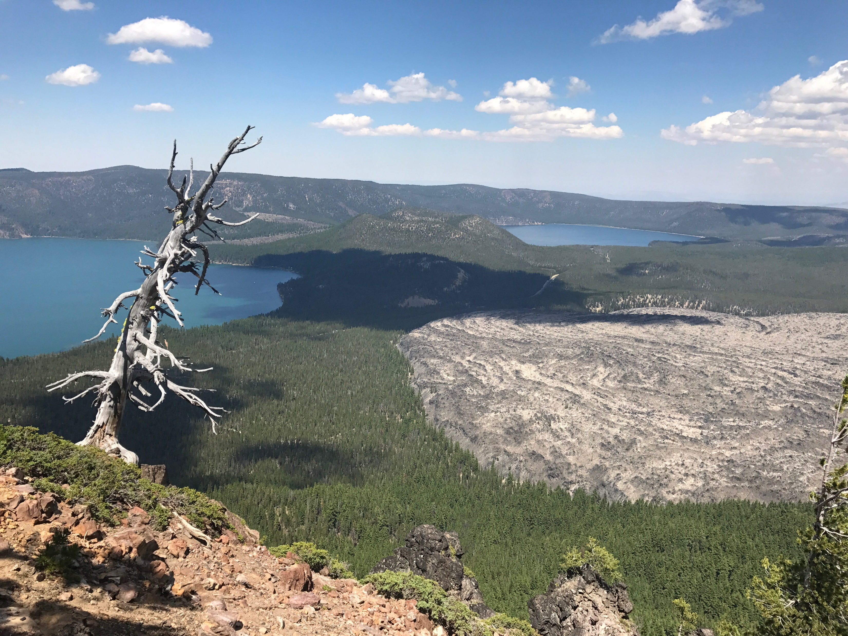
OBSIDIAN SOURCE 2: NEWBERRY VOLCANO
THE SECOND-CLOSEST OF THE OBSIDIAN SOURCES

Slide 18
Paulina Lake
East Lake

Slide 19
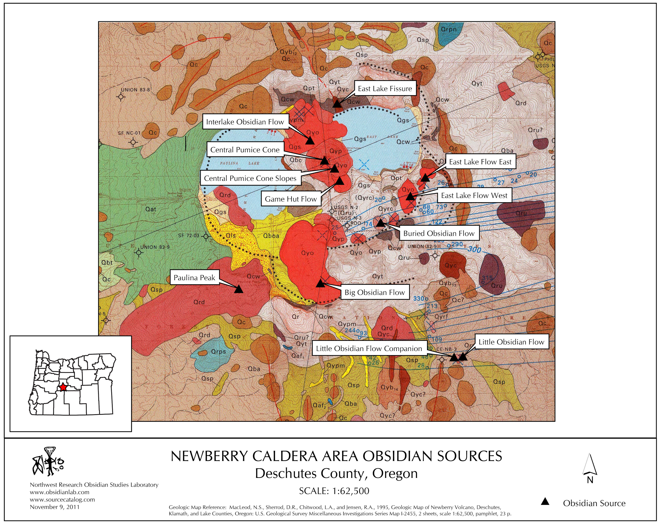
NEWBERRY CALDERA OBSIDIAN SOURCES

Slide 20
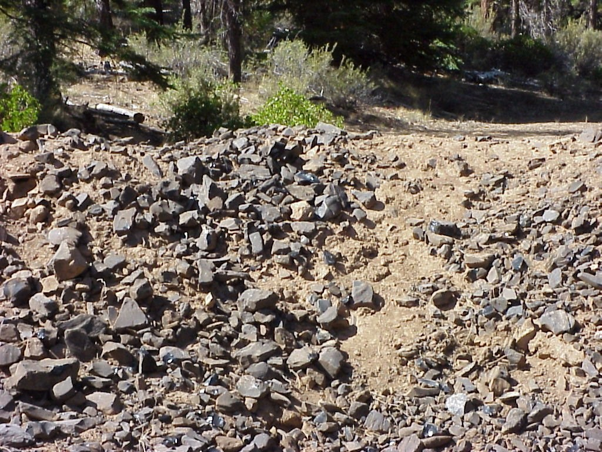
OBSIDIAN SOURCE 3: SILVER LAKE/SYCAN MARSH
ONE OF THE MOST WIDELY-USED SOURCES IN E. OREGON
THE SECOND-MOST DISTANT SOURCE FROM THE CAVES

Slide 21
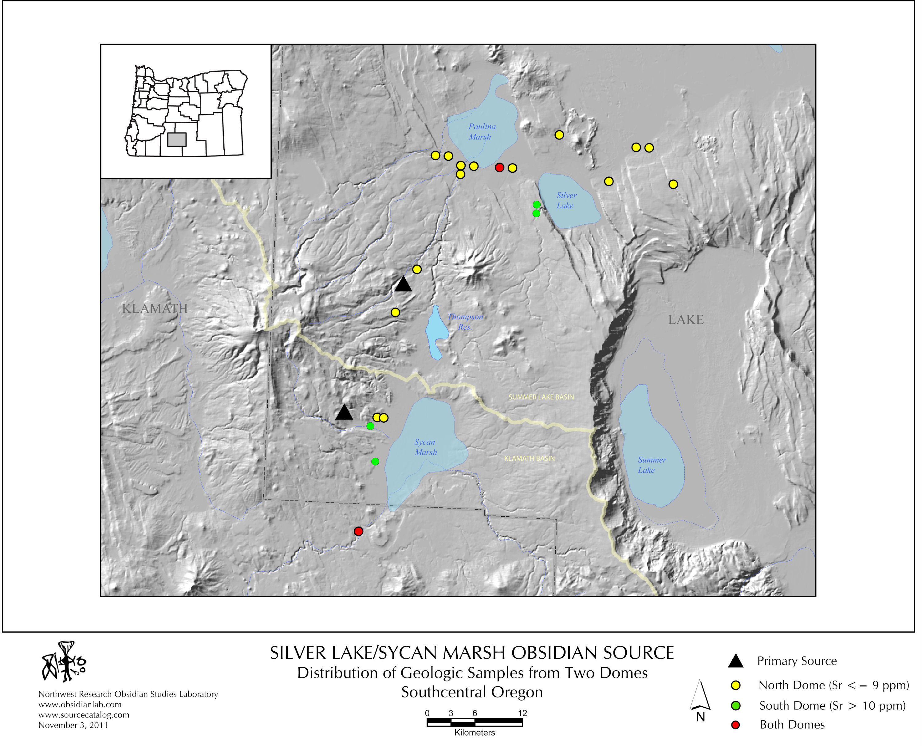

Slide 22
OBSIDIAN SOURCE 4: GLASS BUTTES VARIETY 1
WE’VE FOUND NINE GEOCHEMICALLY-DISTINCTIVE TYPES OF OBSIDIAN IN THE GLASS BUTTES SOURCE COMPLEX
GLASS BUTTES 1 IS THE MOST COMMONLY IDENTIFIED OF THE NINE SOURCE VARIETIES
THIS IS THE MOST DISTANT SOURCE OF THE FOUR

Slide 23
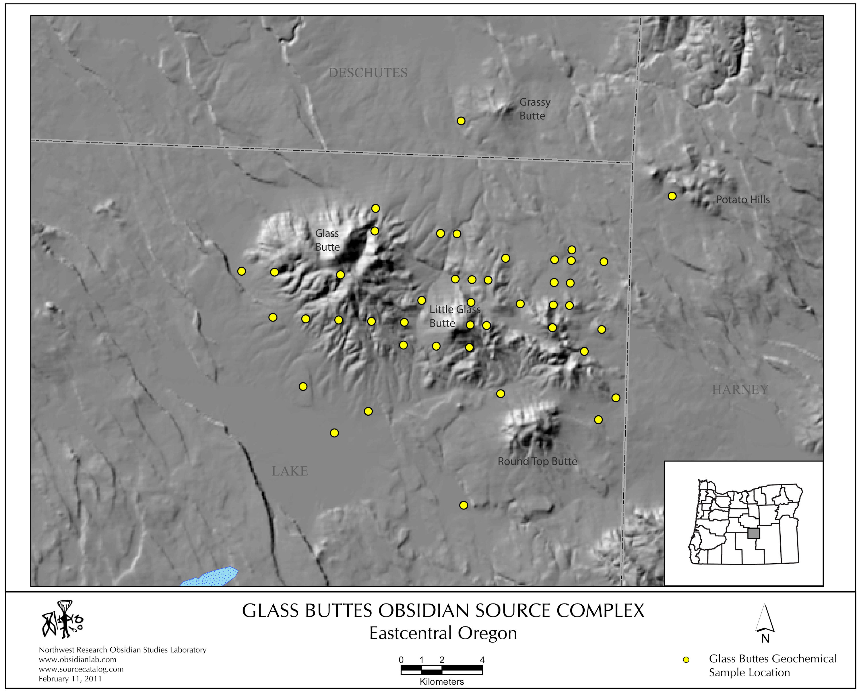

Slide 24
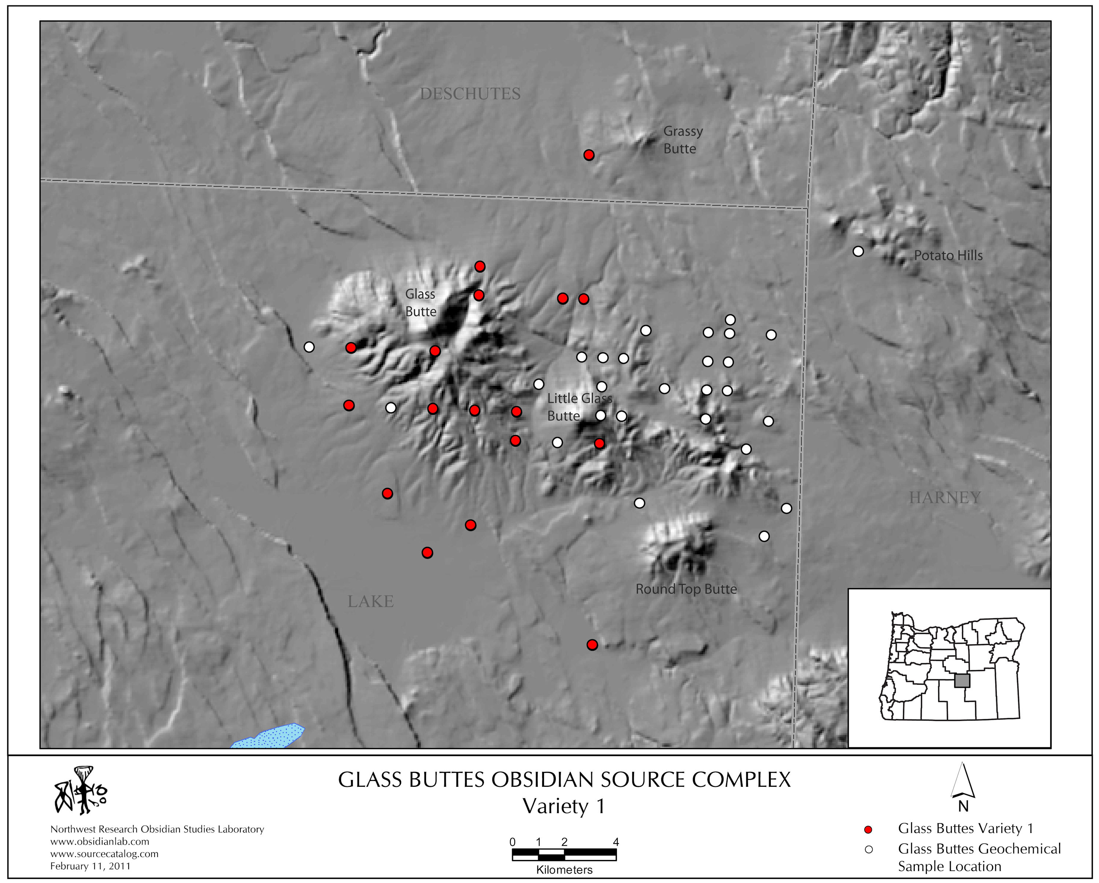

Slide 25
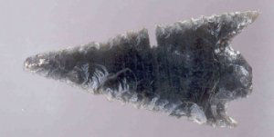
2. OBSIDIAN HYDRATION ANALYSIS: THE BASICS
WATER IS ABSORBED INTO THE SURFACE OF A FRESHLY-FLAKED OBSIDIAN ARTIFACT
A THIN SLICE OF THE ARTIFACT IS REMOVED AND MOUNTED ON A MICROSCOPE SLIDE
THE NARROW HYDRATION RIM IS MEASURED AND PROVIDES AN APPROXIMATE BUT DIRECT DATE OF THE TIME OF MANUFACTURE

Slide 26
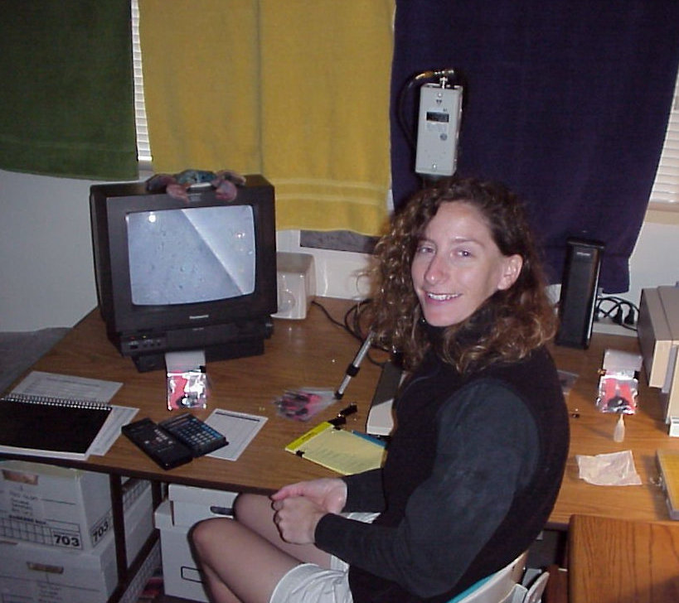
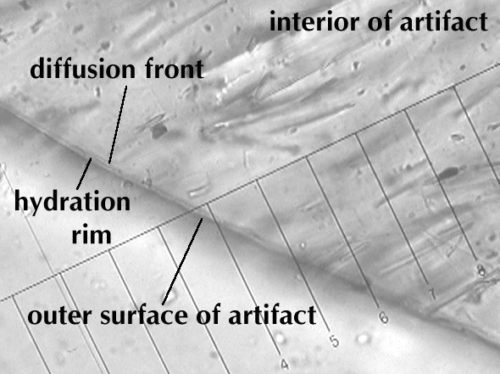

Slide 27
RESULTS OF OBSIDIAN HYDRATION ANALYSIS
 | HYDRATION RIM MEASUREMENT IN MICRONS
SITE | GLASS BUTTES 1 | NEWBERRY VOLCANO | OBSIDIAN CLIFFS | SILVER LAKE/ SYCAN MARSH | TOTAL
CAVE A | — | 2.4, 2.4, 2.5, 2.6 | 2.4 | — | 4
CAVE B | 2.5 | — | 2.3 | — | 2
CAVE C | — | 2.1 | 2.2, 2.2, 2.3 | 4.0 | 5
TOTAL | 1 | 5 | 5 | 1 | 11
THE HYDRATION RIMS SUGGEST THAT THE ARTIFACTS WERE MADE – WITH ONE EXCEPTION – AT ABOUT THE SAME TIME. CALENDAR DATES ARE IMPOSSIBLE TO DETERMINE WITH ANY PRECISION AT THIS POINT.

Slide 28
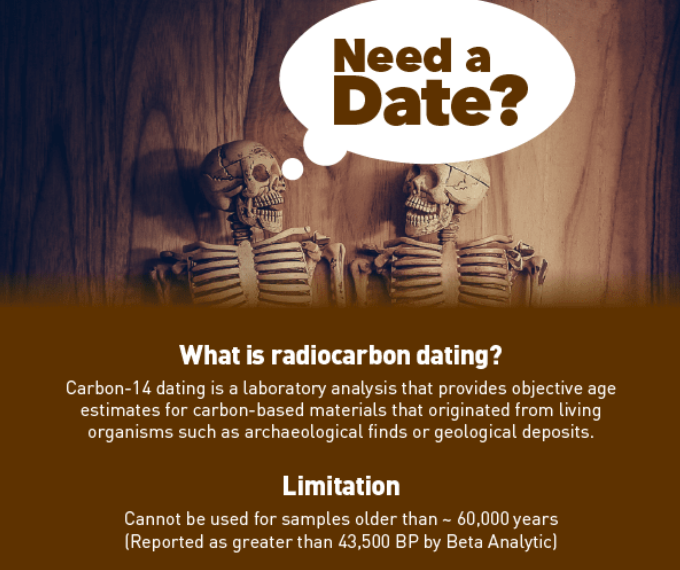
3. RADIOCARBON DATING

Slide 29
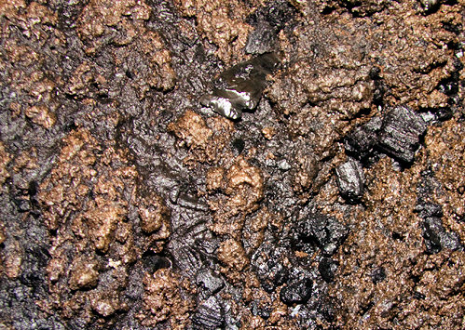
RADIOCARBON DATING OF CHARCOAL
CHARCOAL WAS FOUND IN POSSIBLE ASSOCIATION WITH ARTIFACTS IN ALL THREE CAVES - C14 DATES WOULD PROVIDE CLUES TO WHEN THE ARTIFACTS WERE LEFT
OBSIDIAN POINT AND CHARCOAL IN CAVE A

Slide 30
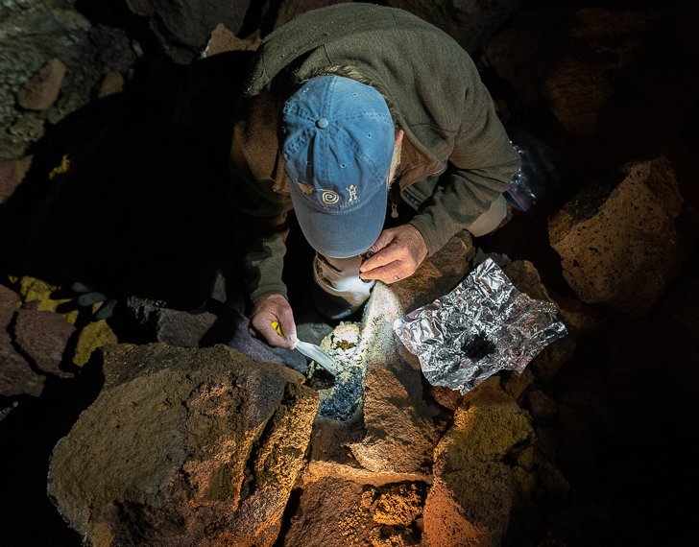
CHARCOAL COLLECTION IN CAVE B
SAMPLING A DISCRETE CONCENTRATION OF CHARCOAL – PERHAPS FROM A TORCH - FOR C14 DATING

Slide 31
RESULTS OF RADIOCARBON DATING
 | RADIOCARBON DATES
SITE | SAMPLE NO. BETA- | C14 YRS. B.P | COMMENTS
CAVE A | 284756 | 5090 +/- 40 | Charcoal - total darkness zone
CAVE B | 518791 | 4090 +/- 30 | Charcoal - total darkness zone
CAVE C | 377161 377162 377163 | 80 +/- 30 3760 +/- 30 3720 +/- 30 | Charcoal - near entrance Charcoal - total darkness zone Charcoal - total darkness zone

Slide 32
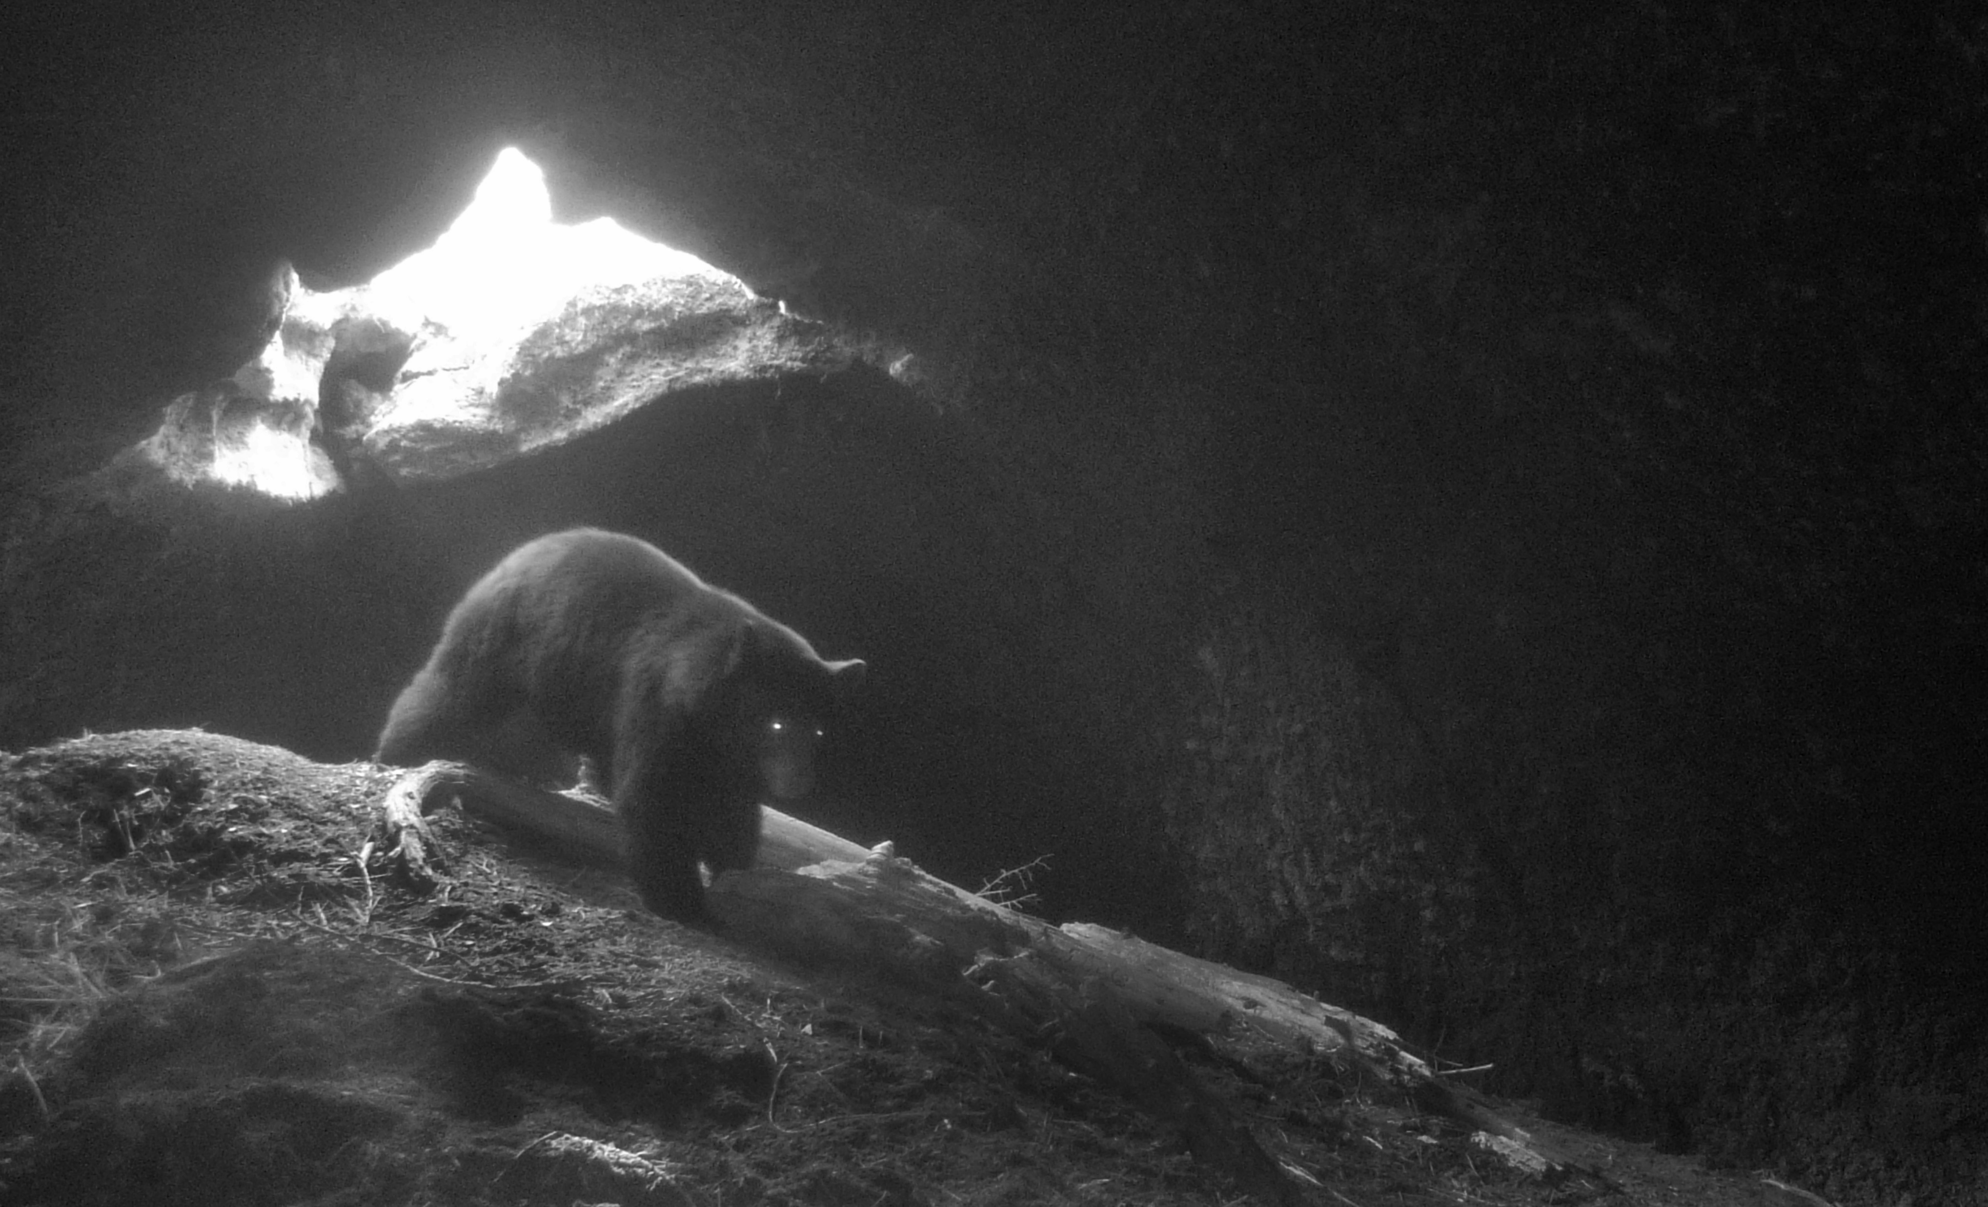
FINALLY … THE BEARS
AND SO … WHAT DO BEARS HAVE TO DO WITH ANY OF THIS?
BEAR IN LAVA TUBE!!

Slide 33
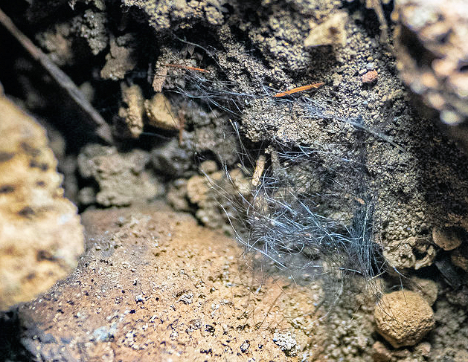
BEAR EVIDENCE
TWO OF THE THREE CAVES HAVE YIELDED EVIDENCE OF BEAR USE
BEAR SKELETAL REMAINS WERE FOUND AT CAVE A
POSSIBLE BEAR HAIR RECOVERED FROM THE INTERIOR OF CAVE B
AND SO … WHAT DOES THIS HAVE TO DO WITH THE OBSIDIAN ARTIFACTS?

Slide 34
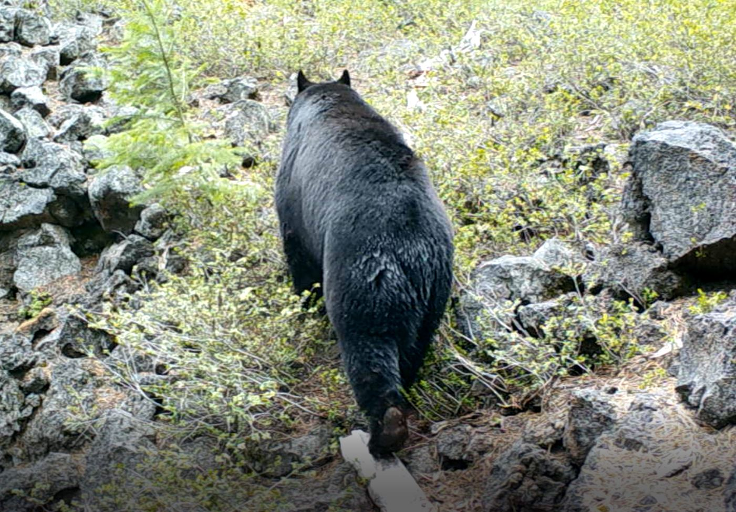
BEARS AND A LITTLE BLOOD
THIS BEAR WAS PHOTO-GRAPHED AT THE ENTRANCE OF A LAVA TUBE LOCATED IN THE VICINITY OF THE THREE STUDY CAVES.
A PROJECTILE POINT WAS ALSO RECOVERED FROM THIS TUBE.
BLOOD RESIDUE ANALYSIS – A METHOD FOR DETERMINING THE SPECIES OF ANIMAL BLOOD FOUND ON AN ARTIFACT - OF THAT ARTIFACT VERY RECENTLY CAME UP POSITIVE FOR THE PRESENCE OF BEAR BLOOD - A FIRST IN CENTRAL OREGON!

Slide 35
CONCLUSIONS: HERE’S WHAT WE KNOW
PEOPLE WERE LEAVING BEHIND FINISHED OBSIDIAN TOOLS IN THE TOTAL DARKNESS ZONE OF LAVA TUBE CAVES
THE ARTIFACTS WERE MANUFACTURED FROM FOUR DIFFERENT LOCAL AND REGIONAL OBSIDIAN SOURCES
THE HYDRATION AGES INDICATE THAT THESE WERE DEFINITELY MANUFACTURED WELL INTO THE PREHISTORIC PERIOD
RADIOCARBON AGES OF CHARCOAL ASSOCIATED WITH THE ARTIFACTS BEAR OUT THE HYDRATION AGES
THERE’S EVIDENCE FOR BEAR HUNTING AND USE AT THE CAVES

Slide 36
AND HERE’S WHAT WE STILL DON’T KNOW
HOW DID THE ARTIFACTS COME TO BE LEFT IN THE CAVES? AND WHY?
WAS IT A FUNCTIONAL REASON – PERHAPS SOMEHOW RELATED TO THE PRESENCE OF BEARS? HUNTING-RELATED?
OR WAS IT CEREMONIAL? SIMPLE CURIOSITY? OR OTHERWISE?
WAS THE CHARCOAL LEFT BEHIND IN THE CAVES FROM TORCHES USED FOR LIGHTING?
MOST RESEARCH GENERATES AS MANY QUESTIONS AS ANSWERS!

Slide 37
WHAT’S NEXT?
WE’RE GETTING CLOSE TO WRAPPING UP THE CURRENT PHASE OF THE RESEARCH OF THE THREE CAVES BUT WE’RE NOT QUITE DONE YET …
THE SEARCH CONTINUES FOR OBSIDIAN ARTIFACTS IN THE CAVES
ADDITIONAL SAMPLING OF CHARCOAL CONCENTRATIONS FOR RADIOCARBON DATING FROM THE CAVES IS NEEDED
FURTHER INVESTIGATIONS OF OBSIDIAN ARTIFACTS ASSOCIATED WITH ADDITIONAL LAVA TUBE CAVES LOCATED IN THE CASCADES AND HIGH DESERT REGIONS OF CENTRAL OREGON IS ONGOING
FINALLY – WE’LL WATCH OUT FOR ADDITIONAL EVIDENCE OF BEARS IN THESE THREE CAVES AND IN OTHER CENTRAL OREGON LAVA TUBES

Slide 38
ACKNOWLEDGEMENTS
OUR THANKS TO:
OREGON HIGH DESERT GROTTO
BRENT MCGREGOR
MATT SKEELS
NEIL MARCHINGTON
WE COULDN’T HAVE DONE IT WITHOUT YOU!

